Slide 1
Down Jones Industrial Average Index Monthly Buy / Hold / Sell Recommendations Victor Antaramian
MIS 637 Project – Fall 2014
Professor Mahmoud Daneshmand

Slide 2
Objective
Develop a model that
For a specific observation of current indicators of the Dow Jones Industrial Average (DJIA) index, recommends whether to Buy / Hold / Sell DJIA index
(If time permits) Also develop a model that Predicts the next period’s return for DJIA
The target audience is a Retail investor who may
have restrictions in terms of frequent trading and
should have longer time horizons in mind (i.e. no day trading)
… hence the time horizon of the recommendation is in the order of Monthly /Quarterly

Slide 3
Background
The chart above shows the closing price of the Dow Jones industrial average over the last decade
Though in this project we will use purely technical indicators (i.e. no macro economic indicators) the assumption is that price history and pattern reflect the ‘crowd’s’ reaction, in terms of buying and selling, to geo-political and macro economic events
Another assumption is that the ‘crowd’s’ psychology does not significantly change over time, so that historical patterns in the price movement of the index reflect that ‘crowd’ psychology and hence can predict where the ‘crowd’ is going next

Slide 4
Key Indicators
Key Indicators to be used as inputs to the model
Moving Averages, and ratios among these – an indication of trends
Observed Volatilities – an indication of fear or uncertainty
For training purposes, output variable - > observed forward Returns
NOTE on Approach
This approach is (purposefully) different from traditional technical analysis techniques which explicitly use indicators such as support and breakout levels. Though the models that will be chosen for this project may end up picking up similar underlying trends and indicators

Slide 5
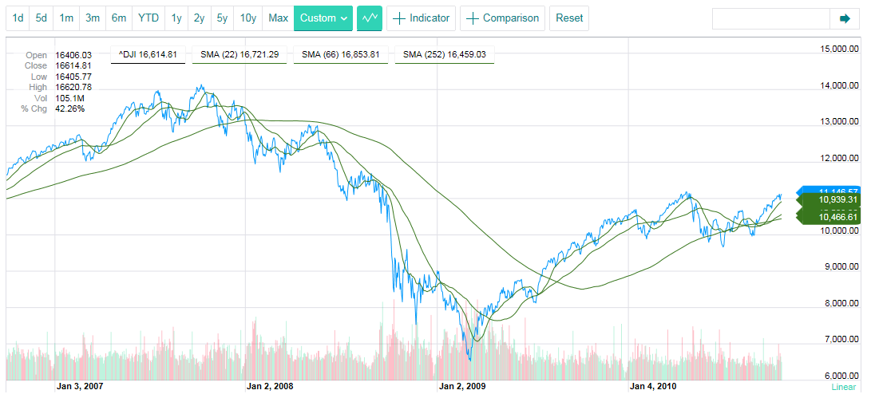
Inputs and Outputs
Input: Observation at a Point in Time
Input : One Month trailing moving average ratios and slope, & Volatility
Input: Three Month trailing moving average ratios and slope, & Volatility
Input: Six Month trailing moving average ratios, and slope
Outputs:
Buy / Hold / Sell Recommendation
If Time permits: Predicted Return

Slide 6
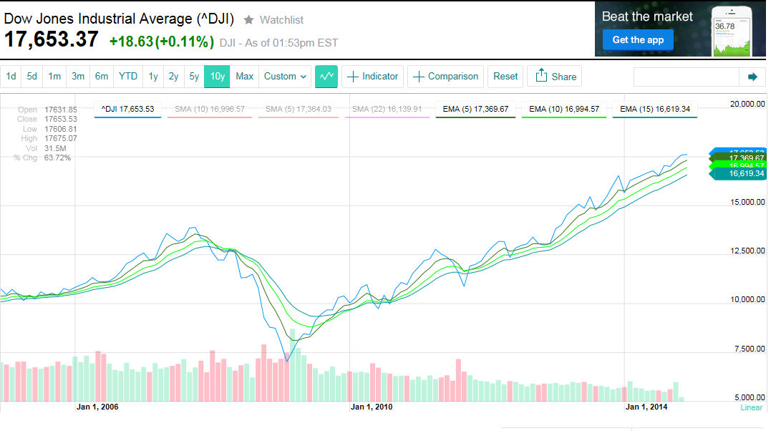
Background Moving Averages
Help smooth the signal – and understand trend
Reduce noise; However, “noise” is an important Indicator – see Volatility as a separate indicator
Exponential moving averages (EMA) weigh recent observations more heavily so will be used instead of simple moving average
From experience will use 21, 63 and 126 trading days as the Moving Average windows
Legend
DJIA
Moving Average : trailing over prior 5 ticks
Moving Average : trailing over prior 10 ticks
Moving Average : trailing over prior 15 ticks

Slide 7
Background Moving Average Indicators
1. Bear Market
Legend
3. Inflection
DJIA
Moving Average : trailing over prior 5 ticks
Moving Average : trailing over prior 10 ticks
Moving Average : trailing over prior 15 ticks
2. Bull Market
1. Bear Market
Long-term moving averages higher than short-term moving averages
Moving averages higher than index
Negative slopes
2. Bull Market
Long term moving averages lower than short-term moving averages
Positive slopes
Moving averages lower than index
3. Inflection
Order of moving averages reverses
Sign of slopes reverse
Use the following inputs to model
Ratio of 6 month EMA to DJIA Index: EMA126_I
Ratio of 3 month EMA to 6 month EMA: EMA63_R
Ratio of 1 month EMA to 3 month EMA: EMA21_R
Slope of 6 month EMA as a ratio to DJIA index
Slope of 3 month EMA as a ratio to DJIA index
Slope of 1 month EMA as a ratio to DJIA index

Slide 8
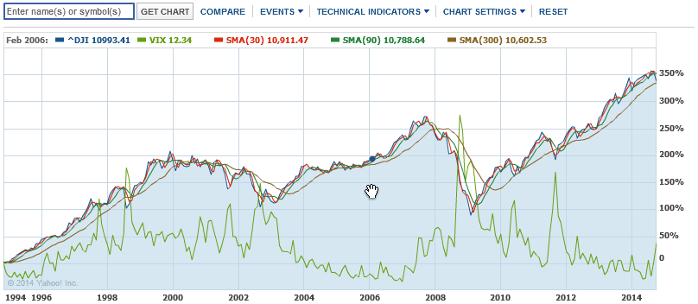
Background Volatility – Measure of “Fear” or “Uncertainty”

Slide 9
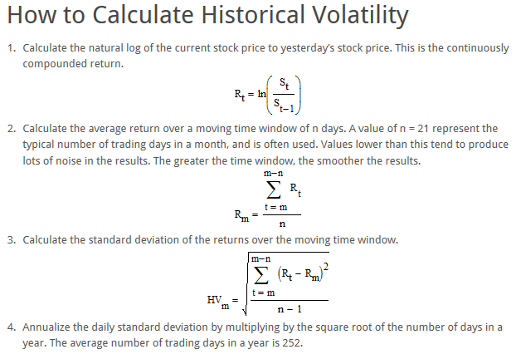
Background Volatility – Measure of “Fear” or “Uncertainty”

Slide 10
Data
Inputs (8 variables) and Target (1 variable)
Input / Output | Variable | Description | Type | Categorized | Normalized
Input | Exponential Moving Averages (EMA) Ratios | Derived for each observation, from EMAs -126 day trailing = EMA126 63 day trailing = EMA63 - 21 day trailing = EMA21 Then for each EMA, the releant rations will be calclated as descived int he above slides - EMA126 / DJIA = EMA126_I EMA63/EMA126 = EMA63_R - EMA21/EMA63 = EMA21_R | Numerical, Continuous | Outlier: less than -3Z 0: -3Z to - 2Z 1: -2Z to -1Z 2: -1Z to 0Z 3: 0Z to 1Z 4: 2Z to 3Z Outlier: more than 3Z | Min Max
Input | Exponential Moving Averages (EMA) Slopes Ratios | First for each observation, the slope of the EMAs will be calculated - 126 day = EMA126_Slope - 63 day = EMA63_Slope - 21 day = EMA21_Slope Then each will be ‘indexed; tot the DJIA level for that observation : - EMA126 / DJIA = EMA126_Sl_I - EMA63/ DJIA = EMA63_Sl_I - EMA21/ DJIA = EMA21_Sl_I | Numerical, Continuous |  | Min Max
Input | Volatilities | Derived for each observation, from daily closes: - 63 day actual annualized (Vol63DayAnn) - 21 day actual annualized (Vol21DayAnn) | Numerical, Continuous |  | Min Max
Target | Return Measure | In Training data, Derived from Returns - Average (1M+1Q)/2 = FwdEReturn | Numerical, Continuous | Outlier: less than -3Z 0 (Sell) : -3Z to – 0.5Z 1(Hold) : -0.5 Z to 0.5 Z 2 (Buy) : 0.5Z to 3Z Outlier: more than 3Z | Min Max

Slide 11
Data
Training and Validation Data
Raw Data – Daily closes since 1900 (snapshot shown above)
Training Data – Started with each end of month across entire time period
Reduce data input to more manageable number
Capture samples uniformly across history
However as models were built a tuned, different sets were used : see slides below
Validation Data – Every other mid month
Reduce data input to more manageable number
Capture samples uniformly across history
However as models were built a tuned, different sets were used : see slides below

Slide 12
Proposed Models
kMeans Cluster
As part of the data understanding phase, run a kMeans Clustering analysis to understand whether it reveals any interesting patterns
Decision tree
For efficiency, translated continuous inputs and target variable into categorical values
Built decision tree with training data
Tested with test data and tuned
Used to predict results with validation data; Measured classification error rates
Neural Network
To calculate Next Month’s predicted return
Normalized inputs and target variables using Min Max (0 to 1)
Measured prediction errors on testing set and validation set
Use of Models – Back Testing (not in scope for this project)
The true test of the models would be to back test the recommendations’ cumulative returns over a time period and compare those to the returns an investor would realize if the just ‘Held’ DJIA, which would be the control measure

Slide 13
Decision Tree Algorithm
C5 will be used
Both C4.5 and C5.0 can produce classifiers expressed either as decision trees or rulesets. C5.0 embodies new algorithms for generating rulesets, with improvements
Accuracy: The C5.0 rulesets can produce lower error rates / smaller rulesets.
Speed: C5.0 is faster; it uses different algorithms and is highly optimized.
Memory: C5.0 commonly uses an order of magnitude less memory than C4.5 during ruleset construction.
Reference - http://rulequest.com/see5-comparison.html

Slide 14
Summary
Monthly Buy / Hold / Sell Recommendations

Slide 15
Data Preparation Sample Data
‘Raw’
Date | Close | FwdEReturn | Vol21DayAnn | Vol63DayAnn | EMA21 | EMA63 | EMA126 | EMA21_Sl | EMA63_Sl | EMA126_Sl
1/31/1900 | 48.4445 | -0.03 | 0.1971 | 0.3335 | 47.65314 | 49.12558 | 50.60529 | -0.002008264 | -0.079532777 | -0.047436733
2/28/1900 | 46.8548 | -0.02 | 0.1188 | 0.3243 | 47.93817 | 48.75544 | 49.98313 | -0.087247005 | -0.028136365 | -0.059122598
3/31/1900 | 48.3639 | -0.05 | 0.1676 | 0.1622 | 46.91434 | 47.42329 | 48.71421 | 0.077138832 | -0.05196293 | -0.042202309
4/30/1900 | 44.9282 | -0.04 | 0.2273 | 0.1877 | 45.90888 | 46.76605 | 47.9653 | -0.097437074 | -0.021396405 | -0.039592945
5/31/1900 | 43.2946 | -0.03 | 0.2024 | 0.1917 | 42.89091 | 44.56927 | 46.26723 | -0.068690046 | -0.078149941 | -0.045844793
Categorized
Date | Close | EMA21_Cat | EMA63_Cat | EMA126_Sl_Cat | EMA126_Cat | EMA63_Sl_Cat | EMA21_Sl_Cat | Vol21DayAnn_Cat | Vol63DayAnn_Cat | FwdEReturn_CatS
1/31/1900 | 48.4445 | 3 | 4 | 2 | 4 | 2 | 3 | 4 | 6 | 0
2/28/1900 | 46.8548 | 4 | 4 | 2 | 5 | 3 | 3 | 3 | 6 | 0
3/31/1900 | 48.3639 | 2 | 3 | 3 | 4 | 3 | 4 | 4 | 4 | 0
4/30/1900 | 44.9282 | 4 | 4 | 2 | 5 | 3 | 2 | 4 | 4 | 0
5/31/1900 | 43.2946 | 3 | 4 | 2 | 5 | 2 | 3 | 4 | 4 | 0
Min Max Normalized
Date | Close | FwdEReturnMM | Vol21DayAnnMM | Vol63DayAnnMM | EMA126_IMM | EMA63_RMM | EMA21_RMM | EMA126_Sl_IMM | EMA63_Sl_RMM | EMA21_Sl_RMM | EMA63_Sl_IMM | EMA21_Sl_IMM
1/31/1900 | 48.4445 | 0.315789 | 0.422898 | 0.809378 | 0.593088 | 0.315513 | 0.308752 | 0.343687 | 0.548232 | 0.039169 | 0.299378 | 0.487516
2/28/1900 | 46.8548 | 0.368421 | 0.22099 | 0.783701 | 0.651803 | 0.345351 | 0.392173 | 0.291168 | 0.548212 | 0.039185 | 0.443597 | 0.348047
3/31/1900 | 48.3639 | 0.210526 | 0.346828 | 0.331287 | 0.494112 | 0.332991 | 0.430254 | 0.363496 | 0.548225 | 0.039161 | 0.377956 | 0.612881
4/30/1900 | 44.9282 | 0.263158 | 0.500774 | 0.402456 | 0.654008 | 0.342542 | 0.382283 | 0.361888 | 0.548213 | 0.039192 | 0.460809 | 0.324555
5/31/1900 | 43.2946 | 0.315789 | 0.436565 | 0.41362 | 0.656821 | 0.267938 | 0.260227 | 0.328876 | 0.548232 | 0.039173 | 0.276754 | 0.369152

Slide 16
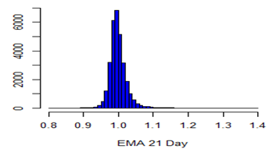
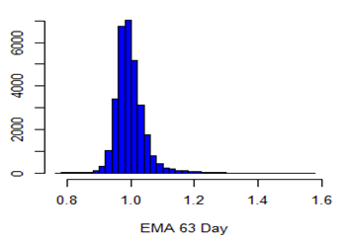
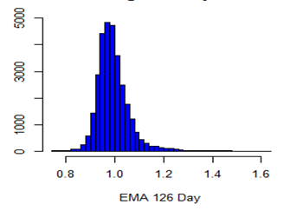
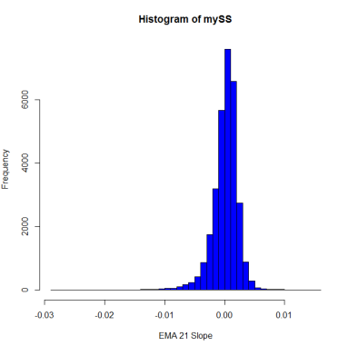
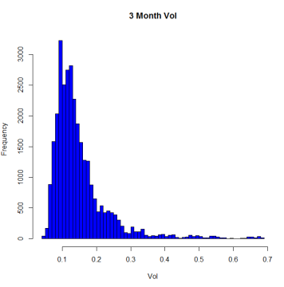
Data Preparation Input and Output Parameters – Summaries and Distributions
EMA21 Index | EMA63 Index | EMA126 Index
EMA21 Slope | EMA63 Slope | EMA126 Slope
Vol21 | Vol63 | FwdReturn
Min 0.8010
1st Qu. 0.9844
Median 0.9959
Mean 0.9988
3rd Qu. 1.0100
Max. 1.3990
Min 0.7618
1st Qu. 0.9689
Median 0.9902
Mean 0.9964
3rd Qu. 1.0160
Max. 1.5680
Min 0.7443
1st Qu. 0.9516
Median 0.9832
Mean 0.9931
3rd Qu. 1.0210
Max. 1.6270
Min -0.0282600
1st Qu. -0.0008322
Median 0.0003920
Mean 0.0001212
3rd Qu. 0.0013910
Max. 0.0153700
Skew = -0.3724162
Min --0.0088750
1st Qu. -0.0004452
Median 0.0002954
Mean 0.0001127
3rd Qu. 0.0008993
Max. 0.0063230
Skew = --0.4197178
Min --0.0080440
1st Qu. -0.0002903
Median 0.0002566
Mean 0.0001047
3rd Qu. 0.0007126
Max. 0.0036380
Skew = -0.4660933
Min. 0.0331
1st Qu. 0.0931
Median 0.1219
Mean 0.1461
3rd Qu. 0.1666
Max. 1.0950
Skew = 0.7931515
Min. 0.0435
1st Qu. 0.0992
Median 0.1279
Mean 0.1508
3rd Qu. 0.1711
Max. 0.6900
Skew = 0.81302
Min. -0.18000
1st Qu. -0.01000
Median 0.01000
Mean 0.00527
3rd Qu. 0.02000
Max. 0.30000
Skew = -0.4430828

Slide 17
Data Preparation
Outliers
Records with outliers in any of the input or target variables will be excluded
Moving Averages
Volatilities
Returns
Z Scores will be used to detect outliers
< - 3Z or > 3Z
Outliers do not represent ‘incorrect’ data points, but times of extreme stress or euphoria in the markets. These would be modeled separately as these market events represent the greatest times of risk / opportunity (out of scope)
Run through ‘Stressed’ model (not in scope)
Is Record Outlier?
Yes
No
Run through ‘Normal’ model (this project)

Slide 18
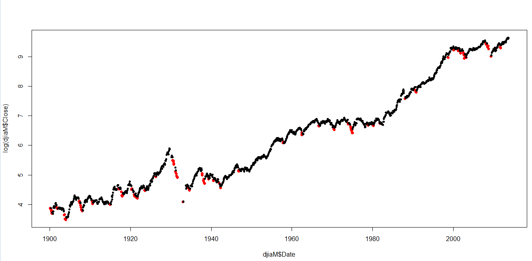
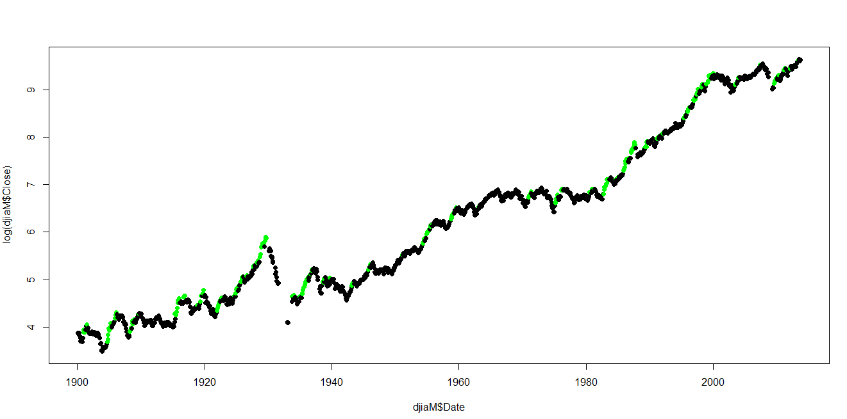
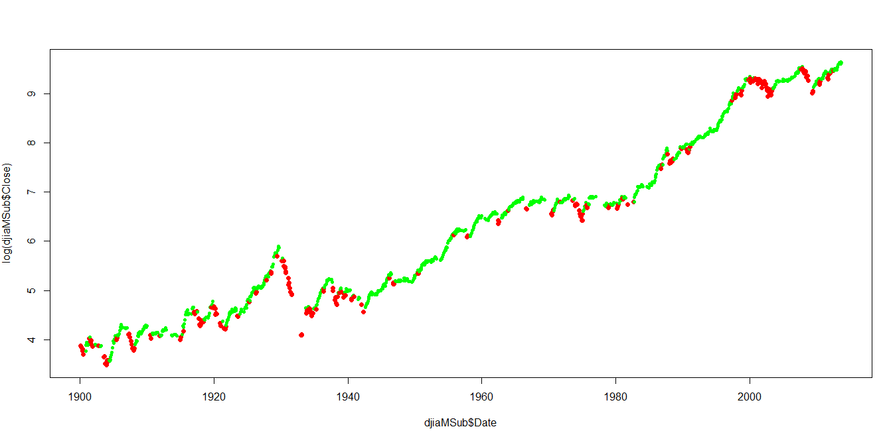
Data Understanding and Modeling kMeans Clustering
Cluster 5 in red
Cluster 1 in green
Log DJIA Level
Log DJIA Level
Year (1900 – 2013)
Year (1900 – 2013)
Approach and Results
As part of the data understanding phase, I ran a kMeans Clustering analysis to understand whether it would reveal any interesting patterns
Used the R kmeans function with k = 5 on the entire monthly data set
Observations
Cluster ‘5’ corresponded to negative returns and in many cases, sell signals, while Cluster 1 corresponded to the highest returns and in many cases to buy signals
May be used for new observations – i.e. observe which single cluster the new observation is closest to and from that categorize which market condition it belongs to. This could then be used to signal entry and exit points from the market – for example ‘3 consecutive green clusters signal entry, three consecutive red clusters signal exit, alternating red and green mean hold
Cluster 1 & 2 in green
Cluster 3 & 5 in red
Log DJIA Level
Sell signals
Buy signals
Year (1900 – 2013)

Slide 19
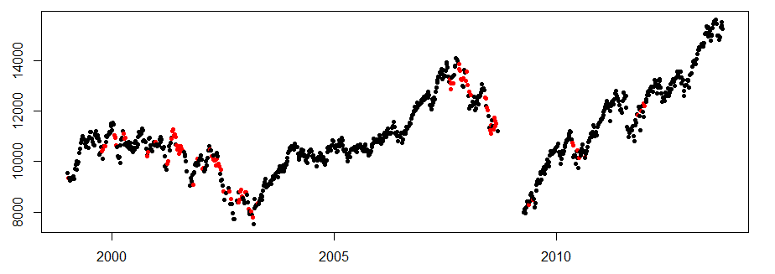
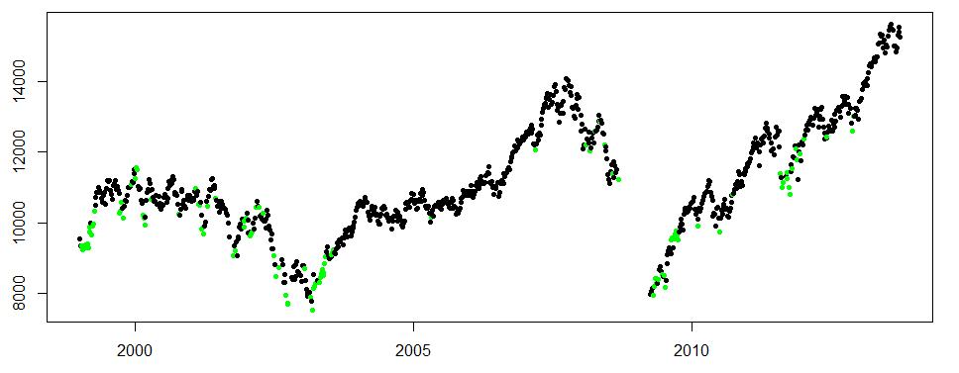
Modeling and Validation C50 Decision Tree
Approach
Trained and tuned a set of decision trees using C50 (using the R C50 package)
Tried different time periods, training and test data sets, and classification schemes for target variable
The chosen decision tree was used to predict Buy | Hold | Sell recommendations for the Validation data
A key finding in the tuning step was that the decision tree for each ‘era’ (e.g. ‘80’s vs. ‘30’s) was significantly different and of significantly different complexities. Even the most complex trees however were built quickly (within a second)
Results
Attribute Usage --- (for period 1999 – 2013)
100.00% Vol63Day
79.03% EMA21_Slope
46.92% EMA63_Slope
46.31% Vol21Day
37.37% EMA126_Index
36.42% EMA126_Slops
32.31% EMA21_Index
27.13% EMA63_Index
Size (decision rule set ): 84
Error Rates:
28% on Training data
31% on Validation data
Conclusions (see charts)
Though a lower error rate is desirable, the decision tree made reasonably accurate predictions to buy or sell per the charts to the right, though there were some false buy / sell signals
Similar to the kMeans cluster analysis, Buy / Sell decisions . should be made based on a series of consecutive consistent predictions from the model - for example ‘3 consecutive buy recommendations signal entry, three consecutive sell recommendations signal exit
Bottoms seem to have conflicting Buy / Sell signals
Year 1999 - 2013
DJIA Level
Sell predictions C50
Accurate signals
(3 consecutive)
False signals
(3 consecutive)
Year 1999 - 2013
DJIA Level
Buy predictions C50
Accurate signals
(3 consecutive)

Slide 20
Modeling and Validation C50 Decision Tree – Final Decision Rules
Vol63DayAnn_Cat <= 3:
:..EMA21_Sl_Cat > 2: 1 (1344/348)
: EMA21_Sl_Cat <= 2:
: :..EMA63_Cat > 4: 2 (13/1)
: EMA63_Cat <= 4:
: :...Vol21DayAnn_Cat <= 3: 1 (25/5)
: Vol21DayAnn_Cat > 3: 2 (13/4)
Vol63DayAnn_Cat > 3:
:...EMA63_Sl_Cat > 4:
:...EMA126_Sl_Cat > 4: 1 (29/6)
: EMA126_Sl_Cat <= 4:
: :...EMA21_Sl_Cat > 4: 1 (21/7)
: EMA21_Sl_Cat <= 4:
: :...EMA126_Sl_Cat <= 3: 2 (4)
: EMA126_Sl_Cat > 3:
: :...Vol21DayAnn_Cat <= 3: 2 (13/4)
: Vol21DayAnn_Cat > 3:
: :...EMA63_Cat <= 2: 2 (7/2)
: EMA63_Cat > 2: 1 (15/3)
EMA63_Sl_Cat <= 4:
:...Vol21DayAnn_Cat <= 3:
:...EMA21_Cat > 4: 0 (13/4)
: EMA21_Cat <= 4:
: :...EMA63_Sl_Cat <= 3: 1 (20/3)
: EMA63_Sl_Cat > 3:
: :...EMA21_Sl_Cat <= 3: 0 (31/8)
: EMA21_Sl_Cat > 3:
: :...EMA63_Cat <= 2: 1 (4/2)
: EMA63_Cat > 2:
: :...EMA63_Cat <= 3: 1 (89/37)
: EMA63_Cat > 3: 0 (5/1)
Vol21DayAnn_Cat > 3:
:...EMA126_Cat > 4:
:...EMA126_Sl_Cat <= 1: 2 (9)
: EMA126_Sl_Cat > 1:
: :...EMA126_Sl_Cat > 3:
: :...Vol21DayAnn_Cat <= 4: 2 (7)
: : Vol21DayAnn_Cat > 4:
: : :...EMA63_Sl_Cat <= 2: 2 (3)
: : EMA63_Sl_Cat > 2: 1 (3)
: EMA126_Sl_Cat <= 3:
: :...EMA63_Sl_Cat <= 1:
: :...EMA63_Cat <= 4: 1 (7/2)
: : EMA63_Cat > 4: 2 (9/2)
: EMA63_Sl_Cat > 1:
: :...EMA63_Cat <= 4:
: :...Vol21DayAnn_Cat <= 4: 2 (6/2)
: : Vol21DayAnn_Cat > 4: 0 (7/1)
: EMA63_Cat > 4:
: :...Vol21DayAnn_Cat > 4:
: :...EMA126_Sl_Cat <= 2:
: : :...EMA63_Cat > 5: 2 (2)
: : : EMA63_Cat <= 5:
: : : :...EMA63_Sl_Cat <= 2: 1 (8/2)
: : : EMA63_Sl_Cat > 2: 0 (2)
: : EMA126_Sl_Cat > 2:
: : :...EMA63_Cat <= 5: 2 (25/7)
: : EMA63_Cat > 5:
: : :...EMA21_Sl_Cat <= 1: 2 (3/1)
: : EMA21_Sl_Cat > 1: 0 (3)
: Vol21DayAnn_Cat <= 4:
: :...EMA63_Cat > 5:
: :...EMA21_Cat <= 5: 0 (3)
: : EMA21_Cat > 5: 1 (5)
: EMA63_Cat <= 5:
: :...EMA63_Sl_Cat > 2: 1 (27/14)
: EMA63_Sl_Cat <= 2:
: :...EMA21_Cat <= 4: 0 (12/6)
: EMA21_Cat > 4:
: :...EMA21_Sl_Cat <= 1: 0 (3/1)
: EMA21_Sl_Cat > 1: 2 (12/5)
EMA126_Cat <= 4:
:...EMA63_Sl_Cat <= 3:
:...EMA21_Cat <= 2:
: :...EMA126_Cat <= 3: 1 (45/9)
: : EMA126_Cat > 3:
: : :...Vol63DayAnn_Cat <= 4: 2 (5/1)
: : Vol63DayAnn_Cat > 4: 1 (18/4)
: EMA21_Cat > 2:
: :...Vol63DayAnn_Cat > 4:
: :...Vol21DayAnn_Cat <= 4:
: : :...Vol63DayAnn_Cat <= 5: 1 (32/6)
: : : Vol63DayAnn_Cat > 5: 0 (4)
: : Vol21DayAnn_Cat > 4:
: : :...Vol21DayAnn_Cat > 5:
: : :...EMA63_Cat <= 3: 1 (4/1)
: : : EMA63_Cat > 3:
: : : :...EMA126_Sl_Cat <= 2: 0 (3)
: : : EMA126_Sl_Cat > 2: 1 (5)
: : Vol21DayAnn_Cat <= 5:
: : :...EMA126_Cat <= 3: 0 (6/2)
: : EMA126_Cat > 3:
: : :...EMA126_Sl_Cat > 2: 2 (22/6)
: : EMA126_Sl_Cat <= 2:
: : :...EMA126_Sl_Cat <= 1: 2 (4)
: : EMA126_Sl_Cat > 1: 0 (4/1)
: Vol63DayAnn_Cat <= 4:
: :...EMA126_Sl_Cat > 3:
: :...Vol21DayAnn_Cat > 4: 1 (16/3)
: : Vol21DayAnn_Cat <= 4:
: : :...EMA126_Cat <= 3:
: : :...EMA63_Cat > 3: 1 (6)
: : : EMA63_Cat <= 3:
: : : :...EMA21_Sl_Cat <= 3: 0 (6/1)
: : : EMA21_Sl_Cat > 3: 1 (14/2)
: : EMA126_Cat > 3:
: : :...EMA21_Sl_Cat <= 2: 1 (13/4)
: : EMA21_Sl_Cat > 2:
: : :...EMA63_Cat <= 4: 0 (57/16)
: : EMA63_Cat > 4: 2 (5/1)
: EMA126_Sl_Cat <= 3:
: :...EMA126_Sl_Cat <= 2: 0 (8)
: EMA126_Sl_Cat > 2:
: :...Vol21DayAnn_Cat <= 4:
: :...EMA21_Sl_Cat <= 2: 0 (26/13)
: : EMA21_Sl_Cat > 2: 1 (133/45)
: Vol21DayAnn_Cat > 4:
: :...EMA126_Cat <= 3: 0 (4)
: EMA126_Cat > 3:
: :...EMA63_Cat > 4: 2 (2)
: EMA63_Cat <= 4:
: :...EMA63_Cat <= 3: 2 (13/6)
: EMA63_Cat > 3:
: :...EMA63_Sl_Cat <= 2: 0 (10/5)
: EMA63_Sl_Cat > 2: 1 (6/2)
EMA63_Sl_Cat > 3:
:..EMA126_Sl_Cat > 4: 1 (16/3)
EMA126_Sl_Cat <= 4:
:...Vol21DayAnn_Cat > 4:
:...Vol63DayAnn_Cat > 5: 2 (12/1)
: Vol63DayAnn_Cat <= 5:
: :...EMA21_Cat <= 2: 1 (7)
: EMA21_Cat > 2:
: :...EMA21_Sl_Cat > 3: 2 (14/5)
: EMA21_Sl_Cat <= 3:
: :...EMA126_Cat <= 3: 0 (8/3)
: EMA126_Cat > 3: 1 (19/3)
Vol21DayAnn_Cat <= 4:
:...Vol63DayAnn_Cat > 4:
:..EMA126_Sl_Cat > 3: 1 (2)
: EMA126_Sl_Cat <= 3:
: :...EMA63_Cat <= 3: 0 (48/20)
: EMA63_Cat > 3: 1 (13/6)
Vol63DayAnn_Cat <= 4:
:...EMA63_Cat > 3:
:...EMA63_Cat > 4: 1 (4)
: EMA63_Cat <= 4:
: :...EMA126_Sl_Cat > 3: 0 (35/13)
: EMA126_Sl_Cat <= 3:
: :...EMA21_Sl_Cat <= 3: 2 (19/10)
: EMA21_Sl_Cat > 3: 1 (5/2)
EMA63_Cat <= 3:
:...EMA21_Sl_Cat <= 3:
:...EMA126_Cat <= 3: 2 (16/1)
: EMA126_Cat > 3: 1 (4/1)
EMA21_Sl_Cat > 3:
:...EMA21_Cat > 3: 2 (24/12)
EMA21_Cat <= 3:
:...EMA21_Sl_Cat > 4:
:...EMA63_Cat <= 2: 1 (28/12)
: EMA63_Cat > 2: 0 (7/1)
EMA21_Sl_Cat <= 4:
:...EMA126_Sl_Cat > 3: 2 (40/17)
EMA126_Sl_Cat <= 3:
:...EMA63_Cat <= 2: 1 (4/1)
EMA63_Cat > 2: 2 (30/15)

Slide 21
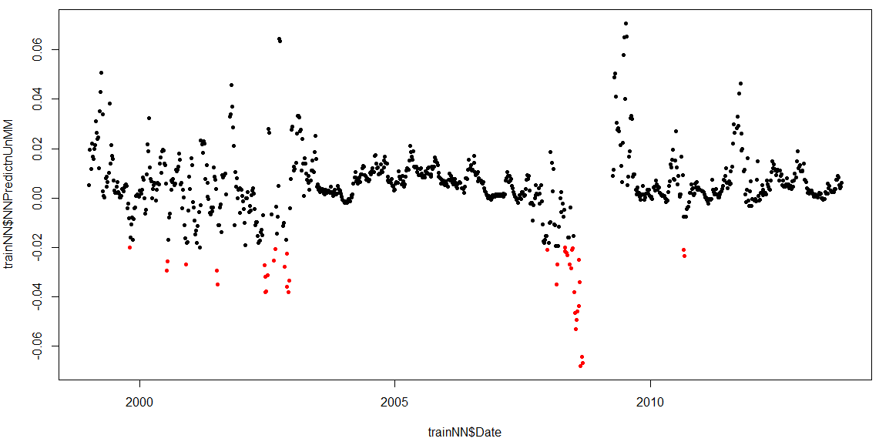
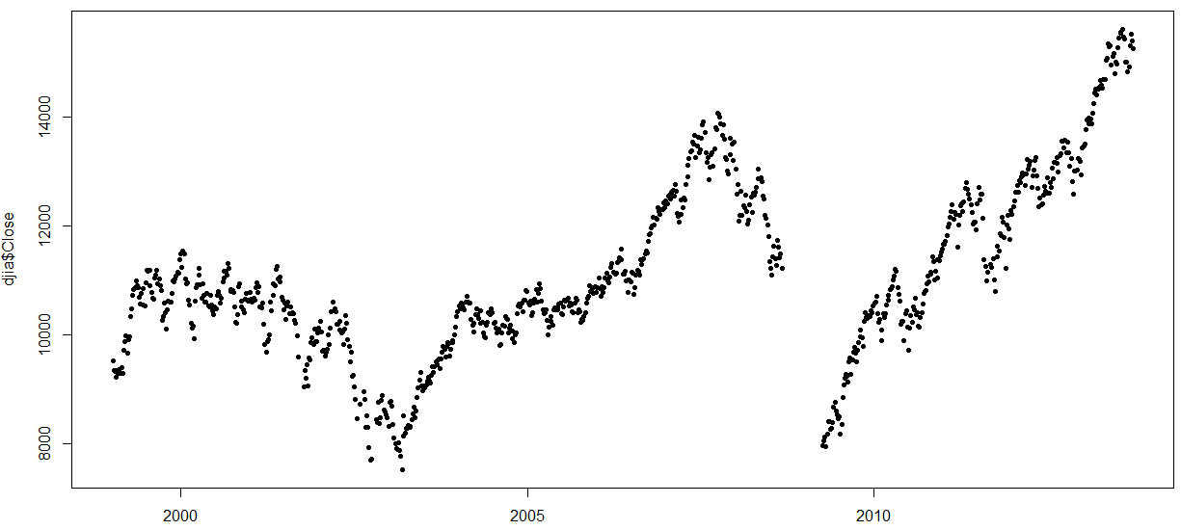
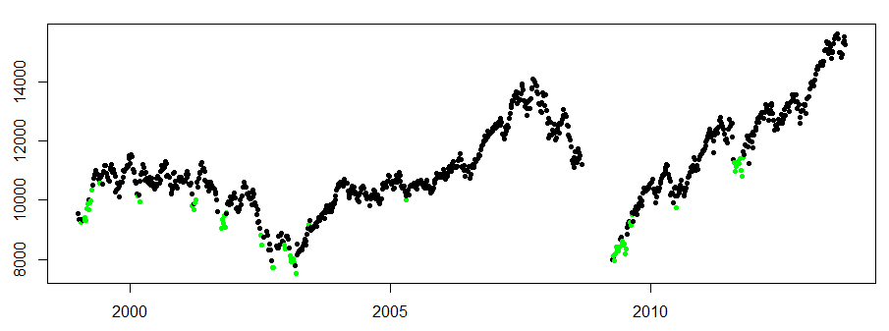
Modeling and Validation Neural Network
Approach
Trained and tuned a set of neural networks using the R neuralnet package
Tried different time periods, training and test data sets, hidden layer sizes and repetition counts
The chosen NN was used to predict Return Rates for the Validation data set
Results
Predicted return rates were fairly inaccurate
However, observations where the NN predicted relatively large negative returns in general corresponded to accurate Sell signals (see charts to the right), especially if the signals occur in sequence over a small period of time
Similarly , observations where the NN predicted relatively large positive returns in general corresponded to accurate Buy signals (see charts to the right), especially if the signals occur in sequence over a small period of time
Prediction <=-0.02
NN Return Predictions 1999-2013
Predicted Return Rate
Accurate Sell signals
False Sell signals
DJIA Levels 1999-2013
(no outliers)
DJIA Level
Prediction >= 0.02 NN
Neural Network Buy Signals
DJIA Level
Accurate Buy signals

Slide 22
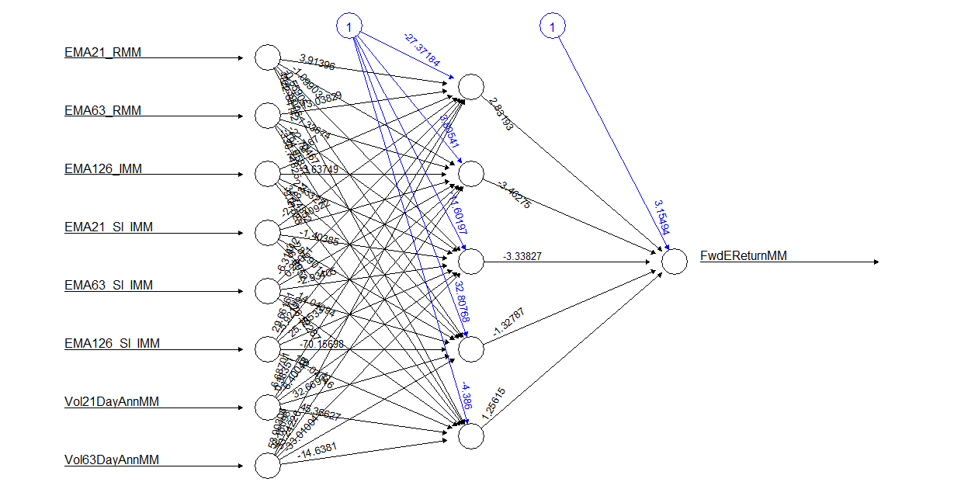
Modeling Step Neural Network –Chosen Configuration

Slide 23
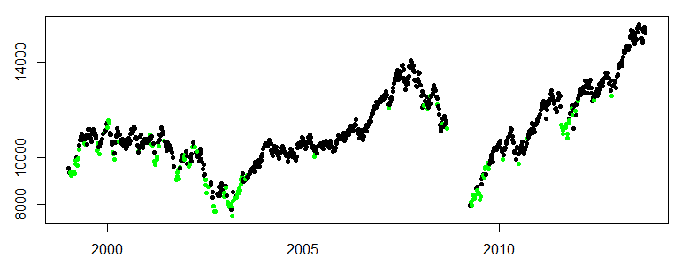
Overall Results
kMeans: ‘sell’ Cluster
C50 & NN Sell Recommendations (in Red)
Conclusions
C50 did a reasonable job of raising Sell and Buy signals, better with Buys
NN did not do a good job of predicting returns but did better in raising Buy / Sell signals – especially Buy signals
The charts on the right show a different view of the signals. The C50 and NN Sell and Buy signals are shown in one plot, and Signals identified when there are 4 or more consecutive consistent predictions
Based on these signals, entry and exit points are shown, with shaded areas for signals to be In the market and Out of the market
The combination of models make a very good job of identifying when to be in the market and when to be out
DJIA Level
C50 & NN Buy Recommendations (in Green)
Buy Signal (4 consecutive)
Sell Signal (4 consecutive)
Conflicting Signal – Hold ?
In Market
Out of Market
Hold

Slide 24
Recommended Next Steps
Create a predictive model that takes in as input a series of signals from the other models to trigger an entry or exit from the market
Back test the model
In
Latest Observation
kMeans
C50
NN
Nearest
cluster
Buy / Hold /
Sell ?
Predicted Return
 | Clusters |  |  |  | C50 Decision Tree |  |  |  | Neural Network
 | Now | Prior | Prior - 2 | Prior - 3 | Now | Prior | Prior - 2 | Prior - 3 | Now | Prior | Prior - 2 | Prior - 3
Date
‘Buffer’
Predictions for last X Observations
NN 2
Out
Recommendation

Slide 25
Appendix

Slide 26
Data
Inputs (8 variables) and Target (1 variable)
Input / Output | Variable | Description | Type | Categorized | Normalized
Raw | DJIA close | Daily closes from 1900 through 2014 | Numerical, Continuous | NA | NA
Intermediate | Exponential Moving Averages (EMA) | Derived for each observation, from prior daily closes: - 126 day trailing (EMA126) - 63 day trailing (EMA63) - 21 day trailing (EMA21) | Numerical, Continuous | NA | NA
Intermediate | Exponential Moving Averages (EMA) Slopes | Derived for each observation, from EMAs - 126 day (EMA126_Sl) - 63 day (EMA63_Sl) - 21 day (EMA21_Sl) | Numerical, Continuous | NA | NA
Intermediate | Returns | Derived for each historical observation - 1 Month (FwdMReturn) - 1 Quarter (FwdQReturn) | Numerical, Continuous | NA | NA
Input | Exponential Moving Averages (EMA) Ratios | Derived for each observation, from EMAs - EMA126 / DJIA = EMA126_I - EMA63/EMA126 = EMA63_R - EMA21/EMA63 = EMA21_R | Numerical, Continuous | Outlier: less than -3Z 0: -3Z to - 2Z 1: -2Z to -1Z 2: -1Z to 0Z 3: 0Z to 1Z 4: 2Z to 3Z Outlier: more than 3Z | Min Max
Input | Exponential Moving Averages (EMA) Slopes Ratios | Derived for each observation, from EMA Slopes - EMA126 / DJIA = EMA126_Sl_I - EMA63/ DJIA = EMA63_Sl_I - EMA21/ DJIA = EMA21_Sl_I | Numerical, Continuous |  | Min Max
Input | Volatilities | Derived for each observation, from daily closes: - 63 day actual annualized (Vol63DayAnn) - 21 day actual annualized (Vol21DayAnn) | Numerical, Continuous |  | Min Max
Target | Return Measure | In Training data, Derived from Returns - Average (1M+1Q)/2 = FwdEReturn | Numerical, Continuous | Outlier: less than -3Z 0 (Sell) : -3Z to – 0.5Z 1(Hold) : -0.5 Z to 0.5 Z 2 (Buy) : 0.5Z to 3Z Outlier: more than 3Z | Min Max

Slide 27
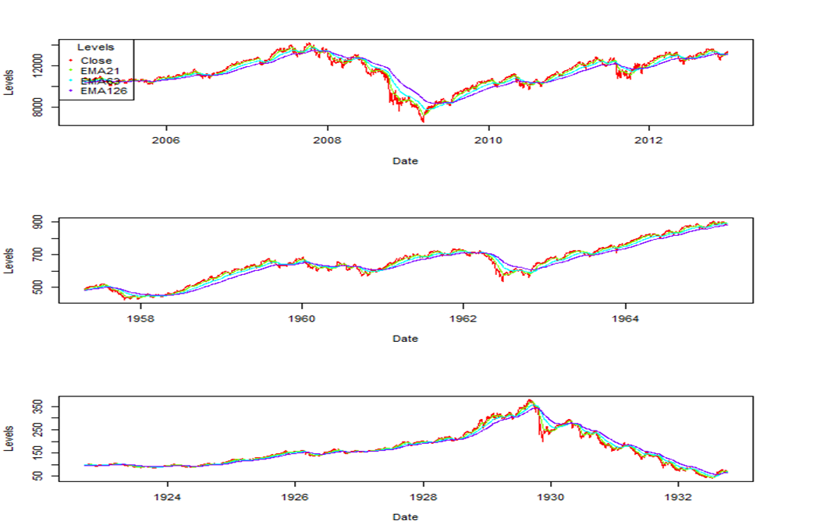
Data Preparation Exponential Moving Averages – Calculations and Indexing
The R EMA function was used to calculate 3 different moving averages ; 21, 63 and 126 trading days
EMA was used in order to weigh recent observations more heavily than past observations
For illustration the EMAs calculated are plotted below for 3 different time periods

Slide 28
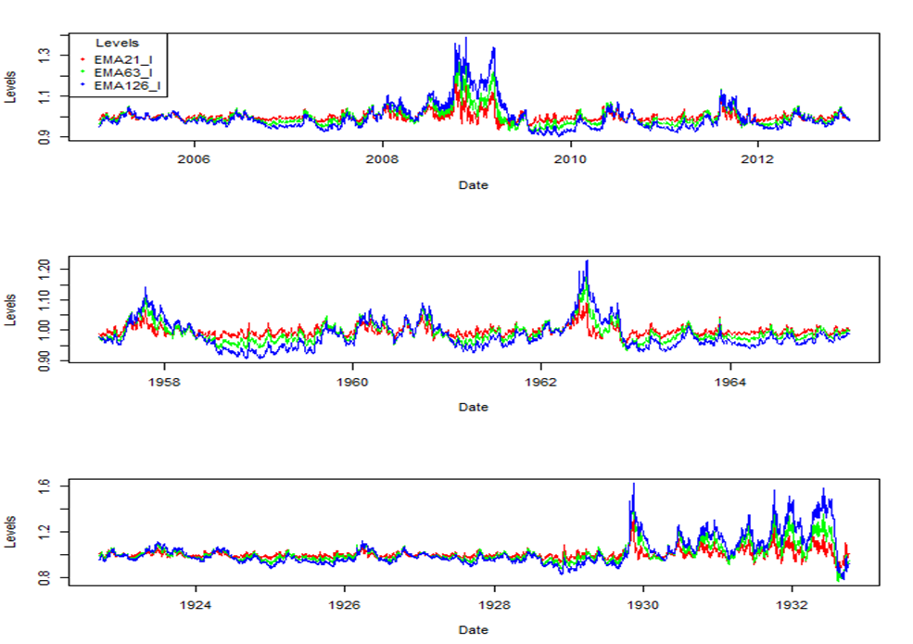
Data Preparation Exponential Moving Averages Slopes – Calculations and Indexing
To account for the rising value of the DJIA over time, the EMAs were “indexed” against the DJIA; EMA_I = EMA/DJIA
For illustration the indexed EMAs calculated are plotted below for 3 different time periods

Slide 29
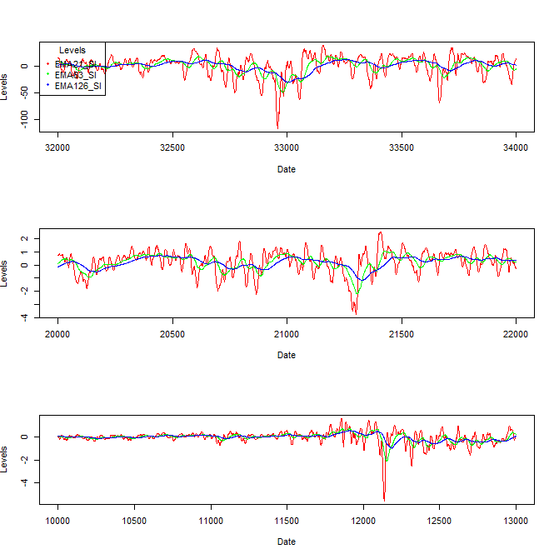
Data Preparation Exponential Moving Averages Slopes – Calculations
The slopes of the EMAs were calculated for each observation as well
For simplicity: EMA_Sl= [EMACurr-EMAt/2] / t/2. For example EMA21_Sl = [EMACurr-EMA10pointsago] / 10
For illustration the indexed EMA Slopes calculated are plotted below for 3 different time periods

Slide 30
Data Preparation Example
For illustration the different derived values for a specific time period are shown below
DJIA and EMAs
Indexed EMAs
EMA Slopes

Slide 31
Data Preparation Volatility – Calculation
Option prices could be used to understand implied, or expected, volatility however this data is not available for the entire historical period

Slide 32
Data Exploration And Preparation Input and Output Parameters
EMA21 Index | EMA63 Index | EMA126 Index
EMA21 Slope | EMA63 Slope | EMA126 Slope
Vol21 | Vol63 | FwdReturn
Min 0.8010
1st Qu. 0.9844
Median 0.9959
Mean 0.9988
3rd Qu. 1.0100
Max. 1.3990
Min 0.7618
1st Qu. 0.9689
Median 0.9902
Mean 0.9964
3rd Qu. 1.0160
Max. 1.5680
Min 0.7443
1st Qu. 0.9516
Median 0.9832
Mean 0.9931
3rd Qu. 1.0210
Max. 1.6270
Min -0.0282600
1st Qu. -0.0008322
Median 0.0003920
Mean 0.0001212
3rd Qu. 0.0013910
Max. 0.0153700
Skew = -0.3724162
Min --0.0088750
1st Qu. -0.0004452
Median 0.0002954
Mean 0.0001127
3rd Qu. 0.0008993
Max. 0.0063230
Skew = --0.4197178
Min --0.0080440
1st Qu. -0.0002903
Median 0.0002566
Mean 0.0001047
3rd Qu. 0.0007126
Max. 0.0036380
Skew = -0.4660933
Min. 0.0331
1st Qu. 0.0931
Median 0.1219
Mean 0.1461
3rd Qu. 0.1666
Max. 1.0950
Skew = 0.7931515
Min. 0.0435
1st Qu. 0.0992
Median 0.1279
Mean 0.1508
3rd Qu. 0.1711
Max. 0.6900
Skew = 0.81302
Min. -0.18000
1st Qu. -0.01000
Median 0.01000
Mean 0.00527
3rd Qu. 0.02000
Max. 0.30000
Skew = -0.4430828

Slide 33
Data
Outliers
Records with outliers in any of the input or target variables will be excluded
Moving Averages
Volatilities
Returns
Z Scores will be used to detect outliers
< - 3Z or > 3Z
Outliers do not represent ‘incorrect’ data points, but times of extreme stress or euphoria in the markets. These would be modeled separately as these market events represent the greatest times of risk / opportunity (out of scope)
Run through ‘Stressed’ model (not in scope)
Is Record Outlier?
Yes
No
Run through ‘Normal’ model (this project)

Slide 34
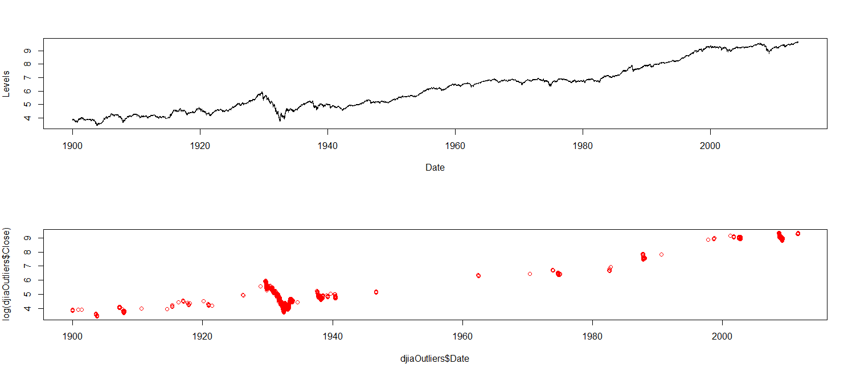
Data Preparation Outliers
Outliers were identified in each of the input and output parameters by using Z Scores
Outliers were those whose Z score was less than or equal to -3Z and greater than or equal to 3Z
Records containing an outlier for any parameter were then removed from the data set
Below is an illustration of the records removed – which represented extreme times of stress on the markets
Crash of ‘29
Pearl Harbor
Black Monday
‘87
Financial Crisis
Log of DJIA
Outliers

Slide 35
Data Preparation Categorization for Decision Tree
Z Scores were used to categorize input variables, to be used as inputs to the decision C50 algorithm in order to simplify branching decisions
CATEGORY THRESHOLDS
Outlier: less than -3Z 0: -3Z to -2Z 1: -2Z to -1Z 2: -1Z to 0Z 3: 0Z to 1Z 4: 2Z to 3Z Outlier: more than 3Z
Z Scores were also used to categorize the target variable
CATEGORY THRESHOLDS
Outlier: less than -3Z 0: (Sell) -3Z to -0.5Z 1: (Hold) -0.5Z to 0.5Z 2: (Buy ) 0.5Z to 3Z Outlier: more than 3Z

Slide 36
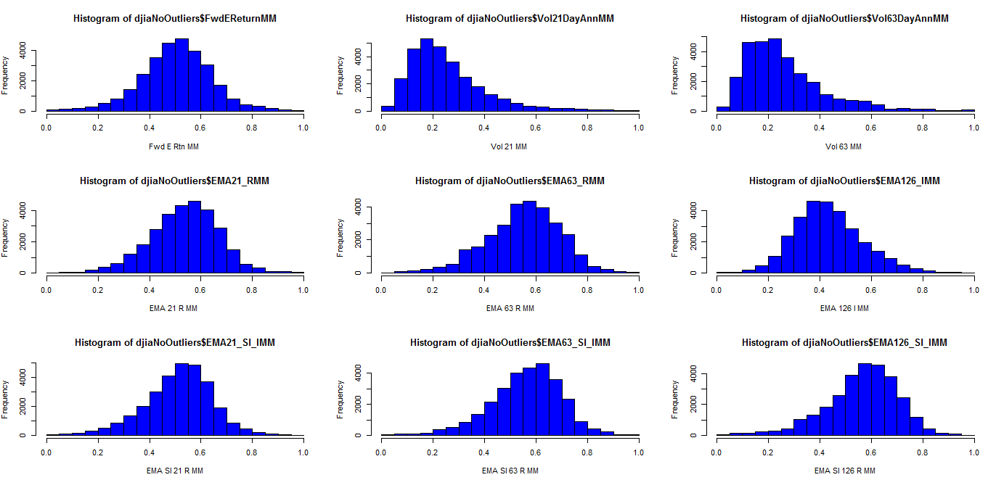
Data Preparation Min Max Normalization for Neural Network
All input variables and the target variable were also MinMax normalized in preparation for use in a Neural Network model

Slide 37
Data Preparation Sample Data
‘Raw’
Date | Close | FwdEReturn | Vol21DayAnn | Vol63DayAnn | EMA21 | EMA63 | EMA126 | EMA21_Sl | EMA63_Sl | EMA126_Sl
1/31/1900 | 48.4445 | -0.03 | 0.1971 | 0.3335 | 47.65314 | 49.12558 | 50.60529 | -0.002008264 | -0.079532777 | -0.047436733
2/28/1900 | 46.8548 | -0.02 | 0.1188 | 0.3243 | 47.93817 | 48.75544 | 49.98313 | -0.087247005 | -0.028136365 | -0.059122598
3/31/1900 | 48.3639 | -0.05 | 0.1676 | 0.1622 | 46.91434 | 47.42329 | 48.71421 | 0.077138832 | -0.05196293 | -0.042202309
4/30/1900 | 44.9282 | -0.04 | 0.2273 | 0.1877 | 45.90888 | 46.76605 | 47.9653 | -0.097437074 | -0.021396405 | -0.039592945
5/31/1900 | 43.2946 | -0.03 | 0.2024 | 0.1917 | 42.89091 | 44.56927 | 46.26723 | -0.068690046 | -0.078149941 | -0.045844793
Categorized
Date | Close | EMA21_Cat | EMA63_Cat | EMA126_Sl_Cat | EMA126_Cat | EMA63_Sl_Cat | EMA21_Sl_Cat | Vol21DayAnn_Cat | Vol63DayAnn_Cat | FwdEReturn_CatS
1/31/1900 | 48.4445 | 3 | 4 | 2 | 4 | 2 | 3 | 4 | 6 | 0
2/28/1900 | 46.8548 | 4 | 4 | 2 | 5 | 3 | 3 | 3 | 6 | 0
3/31/1900 | 48.3639 | 2 | 3 | 3 | 4 | 3 | 4 | 4 | 4 | 0
4/30/1900 | 44.9282 | 4 | 4 | 2 | 5 | 3 | 2 | 4 | 4 | 0
5/31/1900 | 43.2946 | 3 | 4 | 2 | 5 | 2 | 3 | 4 | 4 | 0
Min Max Normalized
Date | Close | FwdEReturnMM | Vol21DayAnnMM | Vol63DayAnnMM | EMA126_IMM | EMA63_RMM | EMA21_RMM | EMA126_Sl_IMM | EMA63_Sl_RMM | EMA21_Sl_RMM | EMA63_Sl_IMM | EMA21_Sl_IMM
1/31/1900 | 48.4445 | 0.315789 | 0.422898 | 0.809378 | 0.593088 | 0.315513 | 0.308752 | 0.343687 | 0.548232 | 0.039169 | 0.299378 | 0.487516
2/28/1900 | 46.8548 | 0.368421 | 0.22099 | 0.783701 | 0.651803 | 0.345351 | 0.392173 | 0.291168 | 0.548212 | 0.039185 | 0.443597 | 0.348047
3/31/1900 | 48.3639 | 0.210526 | 0.346828 | 0.331287 | 0.494112 | 0.332991 | 0.430254 | 0.363496 | 0.548225 | 0.039161 | 0.377956 | 0.612881
4/30/1900 | 44.9282 | 0.263158 | 0.500774 | 0.402456 | 0.654008 | 0.342542 | 0.382283 | 0.361888 | 0.548213 | 0.039192 | 0.460809 | 0.324555
5/31/1900 | 43.2946 | 0.315789 | 0.436565 | 0.41362 | 0.656821 | 0.267938 | 0.260227 | 0.328876 | 0.548232 | 0.039173 | 0.276754 | 0.369152

Slide 38
Data Preparation Training, Testing and Validation Data
For the entire data set available, extracted each End of Week observation
Training Data – extracted every 1st and 3rd observation out of each set of 4 chronologically
Testing Data - extracted every 2nd observation out of each set of 4 chronologically
Validation Data - extracted every 4th observation out of each set of 4 chronologically

Slide 39
Data Understanding / Modeling kMeans Clustering – Model Setup
As part of the data understanding phase, I ran a kMeans Clustering model to understand whether it would reveal any interesting patterns
Used k = 5 with the assumption there may be 5 different types of observations
Bear market (down)
Bull market (up)
Flat market
Inflection from bear to bull
Inflection form bull to bear
As this is unsupervised training, used the entire set of weekly observations, using the MinMax normalized values for the input parameters
Used R kmeans function

Slide 40
Data Understanding / Modeling kMeans Clustering – Results and Interpretation
Cluster Centers
EMA21_RMM EMA63_RMM EMA126_IMM EMA21_Sl_IMM EMA63_Sl_IMM EMA126_Sl_IMM Vol21DayAnnMM Vol63DayAnnMM
1 0.6953287 0.7254358 0.2775756 0.6028672 0.7216355 0.7148539 0.2763515 0.2849050
2 0.5669043 0.5841181 0.4026546 0.5295423 0.5959324 0.5978719 0.1600159 0.1664151
3 0.4156239 0.4367462 0.5599852 0.4180713 0.4465293 0.4659087 0.2383998 0.2346573
4 0.5065914 0.5003696 0.4617714 0.5070294 0.5306600 0.5189613 0.4325532 0.4635390
5 0.2776004 0.2903283 0.7160000 0.3280023 0.2904309 0.3168306 0.5448313 0.5378602
Interpretation - Do these clusters have significantly different Returns ?
Cluster==5
Min. 1st Qu. Median avg Return 3rd Qu. Max.
-0.090000 -0.020000 0.000000 -0.003063 0.020000 0.090000
Cluster==4
Min. 1st Qu. Median avg Return 3rd Qu. Max.
-0.090000 -0.020000 0.010000 0.007721 0.030000 0.070000
Cluster==3
Min. 1st Qu. Median avg Return 3rd Qu. Max.
-0.080000 -0.010000 0.000000 0.002734 0.020000 0.090000
Cluster==2
Min. 1st Qu. Median avg Return 3rd Qu. Max.
-0.090000 -0.010000 0.010000 0.005121 0.020000 0.090000
Cluster==1
Min. 1st Qu. Median avg Return 3rd Qu. Max.
-0.09000 -0.01000 0.01000 0.01008 0.03000 0.09000
Preliminary Conclusions
Cluster 5 shows negative returns, the highest volatilities and the lowest slopes (negative when de-normalized)
Cluster 1 shows the best returns and the highest slopes (positive when de-normalized)

Slide 41
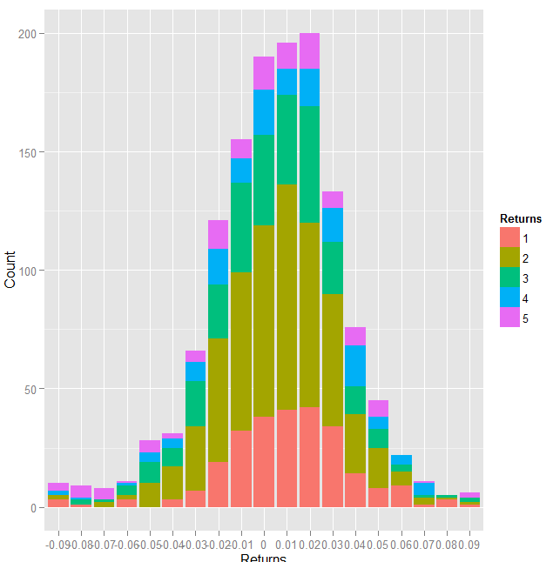
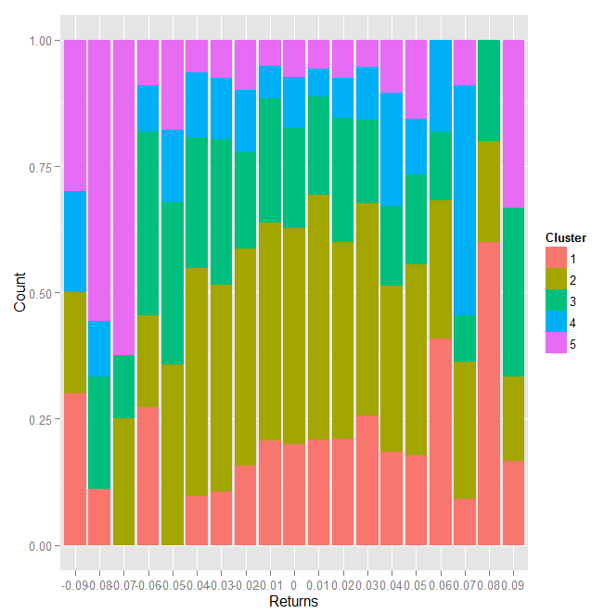
Data Understanding / Modeling kMeans Clustering –Interpretation (Continued)
Created an overlay histogram of returns for the observations, categorized by which cluster they belong to
Negative returns
Positive returns
Cluster
Preliminary Conclusions
Cluster 5 (purple) again tends to be more prevalent for negative returns
Cluster 1 (pink) again tends to be more prevalent for positive returns
Cluster

Slide 42
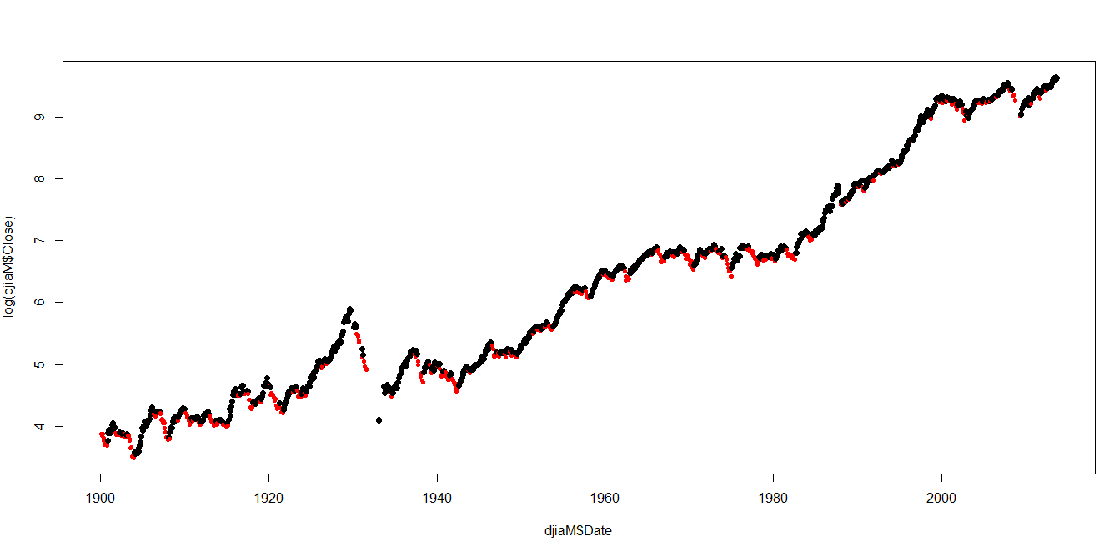
Data Understanding / Modeling kMeans Clustering –Interpretation (Continued)
The data was plotted, highlighting the clusters identified
Preliminary Conclusions
Clusters 5 and 3 correspond to decreasing levels of DJIA
Cluster 5 in red
Log DJIA Level
Year 1900 - 2013
Cluster 3 in red
Log DJIA Level
Year 1900 - 2013

Slide 43
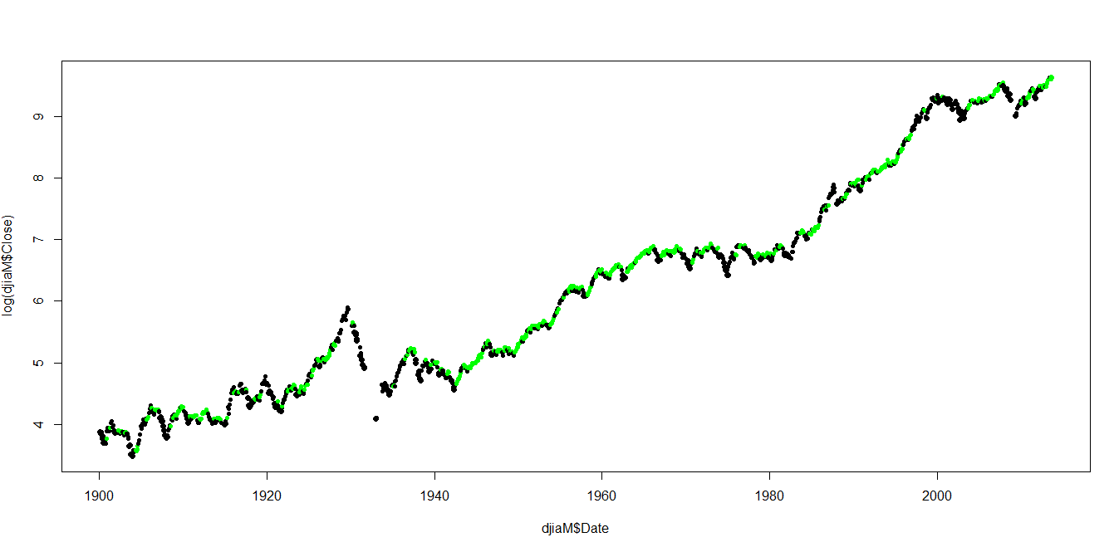
Data Understanding / Modeling kMeans Clustering –Interpretation (Continued)
The data was plotted, highlighting the clusters identified
Preliminary Conclusions
Clusters 1 and 2 correspond to increasing levels of DJIA
Cluster 1 corresponds to higher returns / earlier signals to enter the market
Cluster 2 corresponds to flat or ‘steadily’ rising markets
Cluster 1 in green
Log DJIA Level
Year 1900 - 2013
Cluster 2 in green
Log DJIA Level
Year 1900 - 2013

Slide 44
Modeling Step kMeans Clustering –Conclusions
Conclusions
Clusters seem to correspond well to different market conditions
This means the input variables chosen hopefully are good descriptors of those conditions
The clusters
may be used for k-nearest neighbor analysis for new observations – i.e. observe which single cluster the new observation is closest to and from that categorize which market condition it belongs to. This could then be used to signal entry and exit points from the market – for example ‘3 consecutive green clusters signal entry, three consecutive red clusters signal exit, alternating red and green mean hold
could also be used as a means of dimensional reduction for input to other models
Cluster 1 & 2 in green
Cluster 3 & 5 in red
Log DJIA Level
Sell signals
Buy signals
Year 1900 - 2013

Slide 45
Modeling Step C50 Decision Tree – Inputs and Outputs (with Training Data)
Decision tree
For efficiency, translated continuous inputs and target variable into categorical values
Build decision tree with training data
Test and iterated with testing data
Ran and plotted results with validation data
Inputs and Outputs
Input / Output | Variable | Description | Type | Categorized | Normalized
Input | Exponential Moving Averages (EMA) Ratios | Derived for each observation, from EMAs - EMA126 / DJIA = EMA126_I - EMA63/EMA126 = EMA63_R - EMA21/EMA63 = EMA21_R | Numerical, Continuous | Outlier: less than -3Z 0: -3Z to - 2Z 1: -2Z to -1Z 2: -1Z to 0Z 3: 0Z to 1Z 4: 2Z to 3Z Outlier: more than 3Z | Min Max
Input | Exponential Moving Averages (EMA) Slopes Ratios | Derived for each observation, from EMA Slopes - EMA126 / DJIA = EMA126_Sl_I - EMA63/ DJIA = EMA63_Sl_I - EMA21/ DJIA = EMA21_Sl_I | Numerical, Continuous |  | Min Max
Input | Volatilities | Derived for each observation, from daily closes: - 63 day actual annualized (Vol63DayAnn) - 21 day actual annualized (Vol21DayAnn) | Numerical, Continuous |  | Min Max
Target | Return Measure | In Training data, Derived from Returns - Average (1M+1Q)/2 = FwdEReturn | Numerical, Continuous | Outlier: less than -3Z 0 (Sell) : -3Z to – 0.5Z 1(Hold) : -0.5 Z to 0.5 Z 2 (Buy) : 0.5Z to 3Z Outlier: more than 3Z | Min Max

Slide 46
Modeling Step C50 Decision Tree – C5 vs C4.5
C5 was used
Both C4.5 and C5.0 can produce classifiers expressed either as decision trees or rulesets. C5.0 embodies new algorithms for generating rulesets, with improvements
Accuracy: The C5.0 rulesets can produce lower error rates / smaller rulesets.
Speed: C5.0 is faster; it uses different algorithms and is highly optimized.
Memory: C5.0 commonly uses an order of magnitude less memory than C4.5 during ruleset construction.
Reference - http://rulequest.com/see5-comparison.html
Used R C50 package

Slide 47
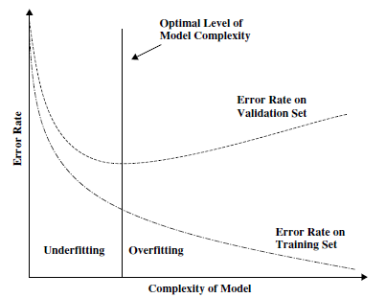
Modeling Step C50 Decision Tree –
Tuning
Trained and tuned a set of decision trees using C50 (using the R C50 package)
Tried different time periods, training and test data sets, and classification schemes for target variable
The chosen decision tree was used to predict Buy | Hold | Sell recommendations for the Validation data
The objective was to find the right balance of right level of complexity of the tree without over fitting the model

Slide 48
Modeling Step C50 Decision Tree –Tuning Iterations [ Results Next Page ]
Initial Training Run: Weekly Train with end of week Training Data Cover entire time period Target : Sell | Hold | Buy NOTE: baseline training run | Testing and Iteration: Daily Train with daily Data Cover entire time period Target : Sell | Hold | Buy NOTE: does a smaller training set significantly affect results ? | Initial Training Run: Clusters Train with end of month Training Data Cover entire time period Target : Sell | Hold | Buy NOTE: added Cluster as an input parameter; does this improve results ?
Testing and Iteration: Buy\Sell Train with end of month Data Cover entire time period Target : Sell | Buy (no Hold category) NOTE: does reduction of number of target categories affect results ? | Testing and Iteration: ‘99-’13 Train with end of month Data Cover ‘99 to ‘13 (age of turbulence) Target : Sell | Hold | Buy NOTE: does focus on a specific time period affect results ? | Testing and Iteration: ‘89-’99 Train with end of month Data Cover ‘89 to ‘99 (great bull market) Target : Sell | Hold | Buy NOTE: does focus on a specific time period affect results ?
Testing and Iteration: ‘45-’60 Train with end of month Data Cover ‘45 to ‘60 (post war boom) Target : Sell | Hold | Buy NOTE: does focus on a specific time period affect results ? | Testing and Iteration: ’29-’45 Train with end of month Data Cover ’29 to ’45 (the great depression) Target : Sell | Hold | Buy NOTE: does focus on a specific time period affect results ?

Slide 49
Modeling Step C50 Decision Tree –Tuning Iterations - Results
Initial Training Run: Weekly | Testing and Iteration: Daily | Initial Training Run: Clusters
Testing and Iteration: Buy\Sell | Testing and Iteration: ‘99-’13 | Testing and Iteration: ‘82-’99
Testing and Iteration: ‘45-’60 | Testing and Iteration: ’29-’45
Attribute Usage
100.00% Vol63Day
31.44% EMA126 Index
29.93% EMA126 Slope
22.30% EMA21 Index
9.60% EMA63 Index
8.84% EMA21 Slope
6.95% Vol21Day
5.52% EMA63 Slope
Size (nodes): 31
Error Rate: 39%
Attribute Usage
100.00% Vol63Day
29.92% EMA126 Slope
28.64% EMA126
18.66% Vol21Day
13.42% EMA63
10.71% EMA21
8.69% EMA63 Slope
3.73% EMA21 Slope
Size (nodes): 80
Error Rate: 34%
Conclusion
Larger data set produced more accurate (and more complex) decision tree
Very similar attribute usage
Attribute Usage
100.00% Clusters
18.67% EMA63
17.31% EMA63 Slope
16.70% Vol21Day
15.80% EMA126
11.11% EMA126 Slope
8.77% EMA21
1.59% EMA21 Slope
Size (nodes): 21
Error Rate: 40%
Conclusion
Cluster became the first decision point – seems to have replaced 63 day volatility
Smaller decision tree but error rate is similar
Attribute Usage
100.00% EMA63 Slope
91.06% Vol21Day
89.95% EMA126 Slope
Size (nodes): 7
Error Rate: 45%
Conclusion
Attribute usage and size of tree greatly simplified
Prediction rate error however is higher
Attribute Usage
100.00% Vol63Day
96.27% EMA21
50.00% EMA63 Slope
43.78% Vol21Day
39.21% EMA126
35.48% EMA63
31.74% EMA126 Slope
8.71% EMA21 Slope
Size (nodes): 24
Error Rate: 30%
Conclusion
Attribute usage different in this time period than for the overall model trained over the entire period
Error rate significantly lower; does each ‘era’ ’ require its own decision tree?
Attribute Usage
100.00% Vol63Day
Size (nodes): 1 (!)
Error Rate: 38%
Conclusion
Error rate similar to baseline run BUT tree has One decision node (!) based on 63 day volatility
82 to 99 was a ‘simpler’ generally rising market pattern
Overall Conclusions
Larger (i.e. daily) training set resulted in more accurate decision tree
Introducing Cluster simplified the decision tree but did not improve accuracy
Simplifying the target variable categorization simplified the decision tree however reduced accuracy
Each ‘era’ requires a different decision tree
Attribute usage varies but the following appear to be the most important in most models: 63 day volatility, 126 day Index and slope
Speed of prediction computations was within 1 second regardless of decision tree complexity
Attribute Usage
100.00% EMA126_Slops
2.71% Vol63Day
4.41% EMA63_Index
Size (nodes): 5
Error Rate: 34%
Conclusion
Seems to support a decision tree for each ‘era’
Attribute Usage
100.00% EMA126_Slope
99.07% Vol63Day
41.16% EMA126_Index
39.53% EMA21_Slope
23.02% EMA63_Slope
22.09% Vol21Day
21.40% EMA63_Index
10.47% EMA21_Index
Size (nodes): 48
Error Rate: 31%
Conclusion
Turbulent time periods (‘30’s, ‘00’s) not surprisingly require a more complex set of decisions

Slide 50
Modeling Step C50 Decision Tree –Final Model and Results
Trained with data set of daily observations covering ‘99 to ’13
Predicted signals with a set of monthly validation data from same time period
Attribute usage
100.00% Vol63Day
79.03% EMA21_Slope
46.92% EMA63_Slope
46.31% Vol21Day
37.37% EMA126_Index
36.42% EMA126_Slops
32.31% EMA21_Index
27.13% EMA63_Index
Size (decisions): 84
Error Rate:
28% on Training data
31% on Validation data
C50 Predictions are plotted here - >
Year 1999 - 2013
DJIA Level
Sell predictions C50
Accurate signals
(3 consecutive)
False signals
(3 consecutive)
Overall Conclusions
Though a lower error rate is desirable, the decision tree made reasonably accurate predictions to buy or sell per the charts to the right, though there were some false buy / sell signals
Buy / Sell decisions should be made based on a series of consecutive consistent predictions from the model
Bottoms seem to have conflicting Buy / Sell signals
Year 1999 - 2013
DJIA Level
Buy predictions C50
Accurate signals
(3 consecutive)

Slide 51
Modeling Step C50 Decision Tree – Final Decision Rules
Vol63DayAnn_Cat <= 3:
:..EMA21_Sl_Cat > 2: 1 (1344/348)
: EMA21_Sl_Cat <= 2:
: :..EMA63_Cat > 4: 2 (13/1)
: EMA63_Cat <= 4:
: :...Vol21DayAnn_Cat <= 3: 1 (25/5)
: Vol21DayAnn_Cat > 3: 2 (13/4)
Vol63DayAnn_Cat > 3:
:...EMA63_Sl_Cat > 4:
:...EMA126_Sl_Cat > 4: 1 (29/6)
: EMA126_Sl_Cat <= 4:
: :...EMA21_Sl_Cat > 4: 1 (21/7)
: EMA21_Sl_Cat <= 4:
: :...EMA126_Sl_Cat <= 3: 2 (4)
: EMA126_Sl_Cat > 3:
: :...Vol21DayAnn_Cat <= 3: 2 (13/4)
: Vol21DayAnn_Cat > 3:
: :...EMA63_Cat <= 2: 2 (7/2)
: EMA63_Cat > 2: 1 (15/3)
EMA63_Sl_Cat <= 4:
:...Vol21DayAnn_Cat <= 3:
:...EMA21_Cat > 4: 0 (13/4)
: EMA21_Cat <= 4:
: :...EMA63_Sl_Cat <= 3: 1 (20/3)
: EMA63_Sl_Cat > 3:
: :...EMA21_Sl_Cat <= 3: 0 (31/8)
: EMA21_Sl_Cat > 3:
: :...EMA63_Cat <= 2: 1 (4/2)
: EMA63_Cat > 2:
: :...EMA63_Cat <= 3: 1 (89/37)
: EMA63_Cat > 3: 0 (5/1)
Vol21DayAnn_Cat > 3:
:...EMA126_Cat > 4:
:...EMA126_Sl_Cat <= 1: 2 (9)
: EMA126_Sl_Cat > 1:
: :...EMA126_Sl_Cat > 3:
: :...Vol21DayAnn_Cat <= 4: 2 (7)
: : Vol21DayAnn_Cat > 4:
: : :...EMA63_Sl_Cat <= 2: 2 (3)
: : EMA63_Sl_Cat > 2: 1 (3)
: EMA126_Sl_Cat <= 3:
: :...EMA63_Sl_Cat <= 1:
: :...EMA63_Cat <= 4: 1 (7/2)
: : EMA63_Cat > 4: 2 (9/2)
: EMA63_Sl_Cat > 1:
: :...EMA63_Cat <= 4:
: :...Vol21DayAnn_Cat <= 4: 2 (6/2)
: : Vol21DayAnn_Cat > 4: 0 (7/1)
: EMA63_Cat > 4:
: :...Vol21DayAnn_Cat > 4:
: :...EMA126_Sl_Cat <= 2:
: : :...EMA63_Cat > 5: 2 (2)
: : : EMA63_Cat <= 5:
: : : :...EMA63_Sl_Cat <= 2: 1 (8/2)
: : : EMA63_Sl_Cat > 2: 0 (2)
: : EMA126_Sl_Cat > 2:
: : :...EMA63_Cat <= 5: 2 (25/7)
: : EMA63_Cat > 5:
: : :...EMA21_Sl_Cat <= 1: 2 (3/1)
: : EMA21_Sl_Cat > 1: 0 (3)
: Vol21DayAnn_Cat <= 4:
: :...EMA63_Cat > 5:
: :...EMA21_Cat <= 5: 0 (3)
: : EMA21_Cat > 5: 1 (5)
: EMA63_Cat <= 5:
: :...EMA63_Sl_Cat > 2: 1 (27/14)
: EMA63_Sl_Cat <= 2:
: :...EMA21_Cat <= 4: 0 (12/6)
: EMA21_Cat > 4:
: :...EMA21_Sl_Cat <= 1: 0 (3/1)
: EMA21_Sl_Cat > 1: 2 (12/5)
EMA126_Cat <= 4:
:...EMA63_Sl_Cat <= 3:
:...EMA21_Cat <= 2:
: :...EMA126_Cat <= 3: 1 (45/9)
: : EMA126_Cat > 3:
: : :...Vol63DayAnn_Cat <= 4: 2 (5/1)
: : Vol63DayAnn_Cat > 4: 1 (18/4)
: EMA21_Cat > 2:
: :...Vol63DayAnn_Cat > 4:
: :...Vol21DayAnn_Cat <= 4:
: : :...Vol63DayAnn_Cat <= 5: 1 (32/6)
: : : Vol63DayAnn_Cat > 5: 0 (4)
: : Vol21DayAnn_Cat > 4:
: : :...Vol21DayAnn_Cat > 5:
: : :...EMA63_Cat <= 3: 1 (4/1)
: : : EMA63_Cat > 3:
: : : :...EMA126_Sl_Cat <= 2: 0 (3)
: : : EMA126_Sl_Cat > 2: 1 (5)
: : Vol21DayAnn_Cat <= 5:
: : :...EMA126_Cat <= 3: 0 (6/2)
: : EMA126_Cat > 3:
: : :...EMA126_Sl_Cat > 2: 2 (22/6)
: : EMA126_Sl_Cat <= 2:
: : :...EMA126_Sl_Cat <= 1: 2 (4)
: : EMA126_Sl_Cat > 1: 0 (4/1)
: Vol63DayAnn_Cat <= 4:
: :...EMA126_Sl_Cat > 3:
: :...Vol21DayAnn_Cat > 4: 1 (16/3)
: : Vol21DayAnn_Cat <= 4:
: : :...EMA126_Cat <= 3:
: : :...EMA63_Cat > 3: 1 (6)
: : : EMA63_Cat <= 3:
: : : :...EMA21_Sl_Cat <= 3: 0 (6/1)
: : : EMA21_Sl_Cat > 3: 1 (14/2)
: : EMA126_Cat > 3:
: : :...EMA21_Sl_Cat <= 2: 1 (13/4)
: : EMA21_Sl_Cat > 2:
: : :...EMA63_Cat <= 4: 0 (57/16)
: : EMA63_Cat > 4: 2 (5/1)
: EMA126_Sl_Cat <= 3:
: :...EMA126_Sl_Cat <= 2: 0 (8)
: EMA126_Sl_Cat > 2:
: :...Vol21DayAnn_Cat <= 4:
: :...EMA21_Sl_Cat <= 2: 0 (26/13)
: : EMA21_Sl_Cat > 2: 1 (133/45)
: Vol21DayAnn_Cat > 4:
: :...EMA126_Cat <= 3: 0 (4)
: EMA126_Cat > 3:
: :...EMA63_Cat > 4: 2 (2)
: EMA63_Cat <= 4:
: :...EMA63_Cat <= 3: 2 (13/6)
: EMA63_Cat > 3:
: :...EMA63_Sl_Cat <= 2: 0 (10/5)
: EMA63_Sl_Cat > 2: 1 (6/2)
EMA63_Sl_Cat > 3:
:..EMA126_Sl_Cat > 4: 1 (16/3)
EMA126_Sl_Cat <= 4:
:...Vol21DayAnn_Cat > 4:
:...Vol63DayAnn_Cat > 5: 2 (12/1)
: Vol63DayAnn_Cat <= 5:
: :...EMA21_Cat <= 2: 1 (7)
: EMA21_Cat > 2:
: :...EMA21_Sl_Cat > 3: 2 (14/5)
: EMA21_Sl_Cat <= 3:
: :...EMA126_Cat <= 3: 0 (8/3)
: EMA126_Cat > 3: 1 (19/3)
Vol21DayAnn_Cat <= 4:
:...Vol63DayAnn_Cat > 4:
:..EMA126_Sl_Cat > 3: 1 (2)
: EMA126_Sl_Cat <= 3:
: :...EMA63_Cat <= 3: 0 (48/20)
: EMA63_Cat > 3: 1 (13/6)
Vol63DayAnn_Cat <= 4:
:...EMA63_Cat > 3:
:...EMA63_Cat > 4: 1 (4)
: EMA63_Cat <= 4:
: :...EMA126_Sl_Cat > 3: 0 (35/13)
: EMA126_Sl_Cat <= 3:
: :...EMA21_Sl_Cat <= 3: 2 (19/10)
: EMA21_Sl_Cat > 3: 1 (5/2)
EMA63_Cat <= 3:
:...EMA21_Sl_Cat <= 3:
:...EMA126_Cat <= 3: 2 (16/1)
: EMA126_Cat > 3: 1 (4/1)
EMA21_Sl_Cat > 3:
:...EMA21_Cat > 3: 2 (24/12)
EMA21_Cat <= 3:
:...EMA21_Sl_Cat > 4:
:...EMA63_Cat <= 2: 1 (28/12)
: EMA63_Cat > 2: 0 (7/1)
EMA21_Sl_Cat <= 4:
:...EMA126_Sl_Cat > 3: 2 (40/17)
EMA126_Sl_Cat <= 3:
:...EMA63_Cat <= 2: 1 (4/1)
EMA63_Cat > 2: 2 (30/15)

Slide 52
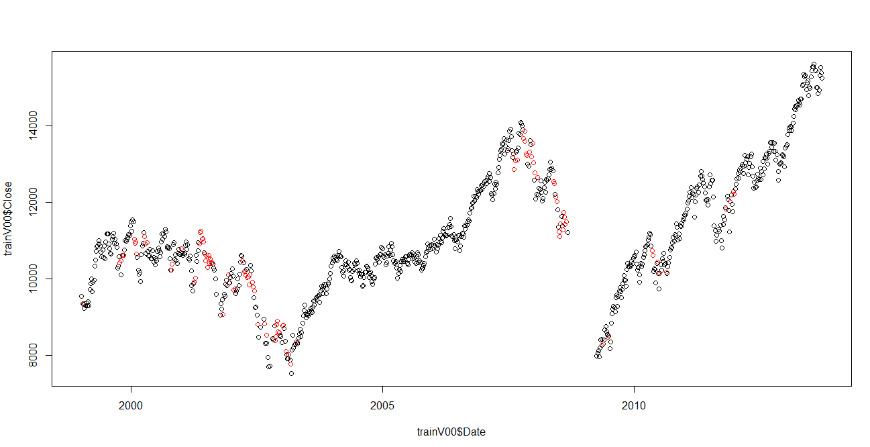
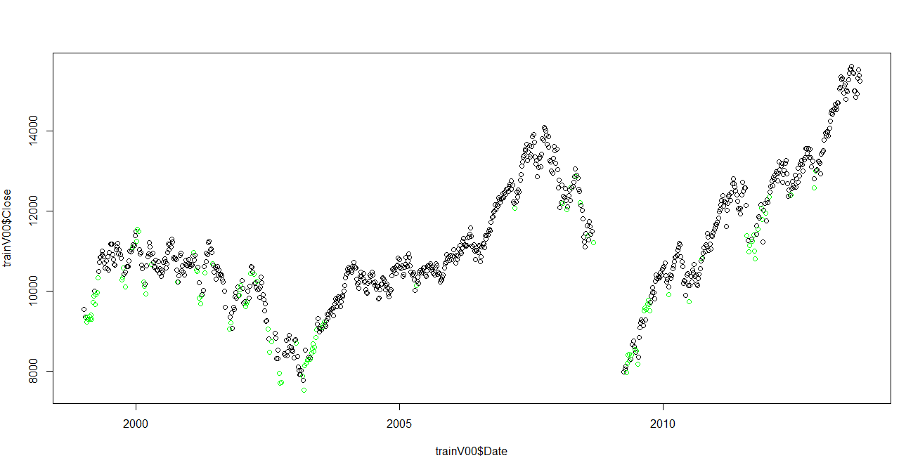
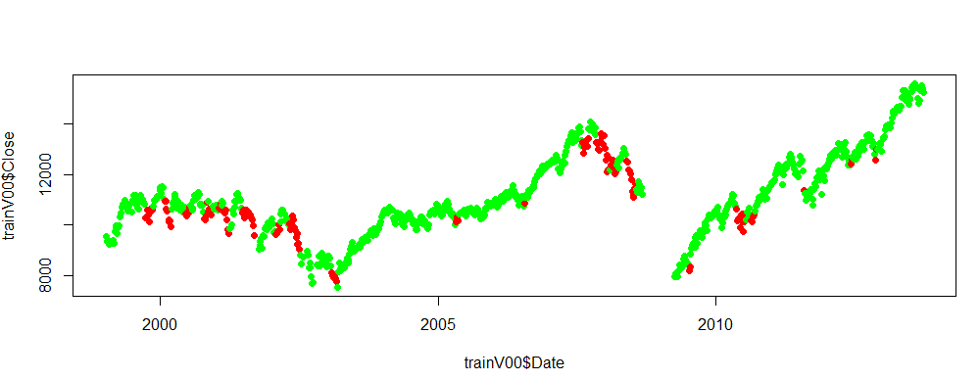
Validation Step C50 Decision Tree Results; In Tandem with kMeans Cluster Analysis
C50 Sell signals
Overall Conclusions
C50 predictions when reinforced by cluster analysis may produce clearer and more accurate signals
DJIA Level
Year 1999 - 2013
C50 Buy signals
DJIA Level
Year 1999 - 2013
kMeans Clusters
DJIA Level
Year 1999 - 2013

Slide 53
Modeling Step Neural Network - Introduction
Neural Network
The R package neuralnet was used
Input parameters and target parameters, once outliers were extracted, were MinMax normalized
Tested and iterated with testing data
Ran and plotted results with validation data
Since the C50 results demonstrated that each ‘era’ has very different characteristics, I focused on modeling and validating the time period 1999 - 2013
Inputs and Outputs
Input / Output | Variable | Description | Type | Categorized | Normalized
Input | Exponential Moving Averages (EMA) Ratios | Derived for each observation, from EMAs - EMA126 / DJIA = EMA126_I - EMA63/EMA126 = EMA63_R - EMA21/EMA63 = EMA21_R | Numerical, Continuous | Outlier: less than -3Z 0: -3Z to - 2Z 1: -2Z to -1Z 2: -1Z to 0Z 3: 0Z to 1Z 4: 2Z to 3Z Outlier: more than 3Z | Min Max
Input | Exponential Moving Averages (EMA) Slopes Ratios | Derived for each observation, from EMA Slopes - EMA126 / DJIA = EMA126_Sl_I - EMA63/ DJIA = EMA63_Sl_I - EMA21/ DJIA = EMA21_Sl_I | Numerical, Continuous |  | Min Max
Input | Volatilities | Derived for each observation, from daily closes: - 63 day actual annualized (Vol63DayAnn) - 21 day actual annualized (Vol21DayAnn) | Numerical, Continuous |  | Min Max
Target | Return Measure | In Training data, Derived from Returns - Average (1M+1Q)/2 = FwdEReturn | Numerical, Continuous | Outlier: less than -3Z 0 (Sell) : -3Z to – 0.5Z 1(Hold) : -0.5 Z to 0.5 Z 2 (Buy) : 0.5Z to 3Z Outlier: more than 3Z | Min Max

Slide 54
Modeling Step Neural Network - Tuning
Tuning Approach
Tried different runs, varying
Time period of training data
Number of neurons in hidden layer
Number of repetitions for a specific configuration
Max number of steps per repetition
Measured error rate as follows
With weights resulting for a specific configuration of the model, predict forward returns with test data
Measure / observe
Error rate and distribution of predictions - > Error % = (predicted value – actual value) / actual value
Distribution of predictions - > do these match distribution of actuals in terms of min / max / mean ?
Chose model with average lowest error %’s and prediction distribution closest to actual

Slide 55
Modeling Step Neural Network –Tuning Iterations [ Results Next Page ]
Initial Training Run: Baseline Train with end of month data (241) Cover ‘99 to ‘13 (age of turbulence) Target : Expected Return Repetitions: One Max steps: 10,000 Hidden Layer: 4 nodes NOTE: baseline training run | Testing and Iteration: A Train with daily data (801) Cover ’10 to ‘13 (post crisis bull market) Target : Expected Return Repetitions: Five Max steps: 20,000 Hidden Layer: 4 nodes NOTE: more targeted time period; larger training data set | Initial Training Run: B Train with daily data (801) Cover ’10 to ‘13 (post crisis bull market) Target : Expected Return Repetitions: Five Max steps: 20,000 Hidden Layer: 2 nodes NOTE: simpler hidden layer
Testing and Iteration: C Train with daily data (801) Cover ’10 to ‘13 (post crisis bull market) Target : Expected Return Repetitions: Six Max steps: 20,000 Hidden Layer: 5 nodes NOTE: more complex hidden layer | Testing and Iteration: D Train with daily data (801) Cover ’10 to ‘13 (post crisis bull market) Target : Expected Return Repetitions: Five Max steps: 40,000 Hidden Layer: 6 nodes NOTE: more complex hidden layer | Testing and Iteration: E Train with daily data (2041) Cover ’05 to ‘13 (crisis and bull market) Target : Expected Return Repetitions: One Max steps: 80,000 Hidden Layer: 6 nodes NOTE: more complex market period
Testing and Iteration: F Train with daily data (2041) Cover ’05 to ‘13 (crisis and bull market) Target : Expected Return Repetitions: Five Max steps: 80,000 Hidden Layer: 5 nodes NOTE: one fewer node | Testing and Iteration: G Train with daily data (2041) Cover ‘99 to ‘13 (age of turbulence) Target : Expected Return Repetitions: Five Max steps: 80,000 Hidden Layer: 5 nodes NOTE: Entire ‘age of turbulence’

Slide 56
Modeling Step Neural Network –Tuning Iterations : Results
Initial Training Run: Baseline | Testing and Iteration: A | Testing and Iteration: B
Testing and Iteration: C | Testing and Iteration: D | Testing and Iteration: E
Testing and Iteration: F | Testing and Iteration: G
ERROR Rate and Distribution
---------------------------------
Min -0.362
1st Q -0.137
Mean 0.120
3rd Q 0.193
Max 8.202
Prediction Distribution
(of Normalized Returns)
---------
Min. : 0.448
Median : 0.504
Max. : 0.524
ERROR Rate and Distribution
---------------------------------
Min. : -0.330
1st Qu. : -0.078
Mean : 0.026
3rd Qu.: 0.088
Max. : 2.096
Prediction Distribution
(of Normalized Returns)
---------
Min. : 0.320
Median : 0.532
Max. : 0.855
ERROR Rate and Distribution
---------------------------------
Min. : -0.322
1st Qu. : -0.073
Mean : 0.033
3rd Qu.: 0.087
Max. : 2.666
Prediction Distribution
(of Normalized Returns)
---------
Min. : 0.333
Median : 0.532
Max. : 0.795
Conclusions
Average of 12% error but can be -36% to 820%
Prediction distribution ‘too tight’ between 0.44 and 0.52
Conclusions
Lower errors and better distribution
Increasing training data set increased accuracy
Conclusions
Slightly higher errors
2 nodes in hidden layer slightly less accurate
ERROR Rate and Distribution
---------------------------------
Min -0.359
1st Q -0.075
Mean 0.024
3rd Q 0.088
Max 1.830
Prediction Distribution
(of Normalized Returns)
---------
Min. : 0.292
Median :0.532
Max. : 0.832
ERROR Rate and Distribution
---------------------------------
Min -0.357
1st Q -0.063
Mean 0.021
3rd Q 0.082
Max 1.214
Prediction Distribution
(of Normalized Returns)
---------
Min. : 0.233
Median :0.532
Max. : 0.804
ERROR Rate and Distribution
---------------------------------
Min -0.680
1st Q -0.112
Mean 0.005
3rd Q 0.104
Max 1.000
Prediction Distribution
(of Normalized Returns)
---------
Min. : 0.151
Median :0.508
Max. : 0.896
Conclusions
Lower errors especially min and max errors
5 nodes increase accuracy though computation time for weights was much higher
Conclusions
Lower errors especially max error
6 nodes increase accuracy though computation time for weights was higher
Conclusions
More complex market periods (peak – crisis – recovery) more difficult to predict accurately ; larger error rates
Overall Conclusions
Hidden layer nodes : significant improvement from 2 to 4 to 5 nodes, less pronounced at 6. Model with 5 modes
End of month data was too sparse to properly train NN: utilize a fuller training data set extracted from daily observations
NN error rates were similar when looking at the 2005 – 2013, and 1999 – 2013 periods. Both had sets of ‘crises’ and ‘bulls’. At the same time error rates for a Bull market were lower, however this is too narrow a set of conditions. So we’ll use training data from the 1999 – 2013 period
ERROR Rate and Distribution
---------------------------------
Min -1.145
1st Q -0.108
Mean 0.002
3rd Q 0.103
Max 1.000
Prediction Distribution
(of Normalized Returns)
---------
Min. : 0.098
Median :0.514
Max. : 0.814
ERROR Rate and Distribution
---------------------------------
Min -1.272
1st Q -0.150
Mean 0.001
3rd Q 0.136
Max 1.000
Prediction Distribution
(of Normalized Returns)
---------
Min. : 0.108
Median :0.497
Max. : 0.849
Conclusions
Error rate similar for 5 nodes similar to 6 nodes BUT that was best of 6 repetitions
Conclusions
Training with the entire ‘99 to ‘13 period produced similar error rates as ‘05 – ’13
Training 5 nodes in hidden layer with 5 repetitions, for 3051 training observations required 20 minutes of computation

Slide 57
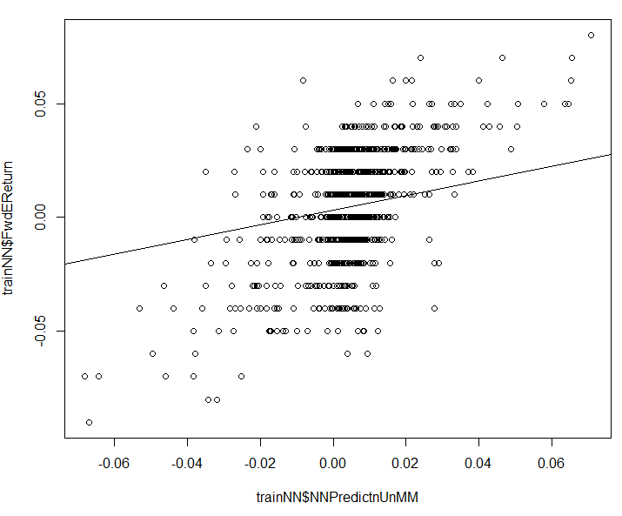
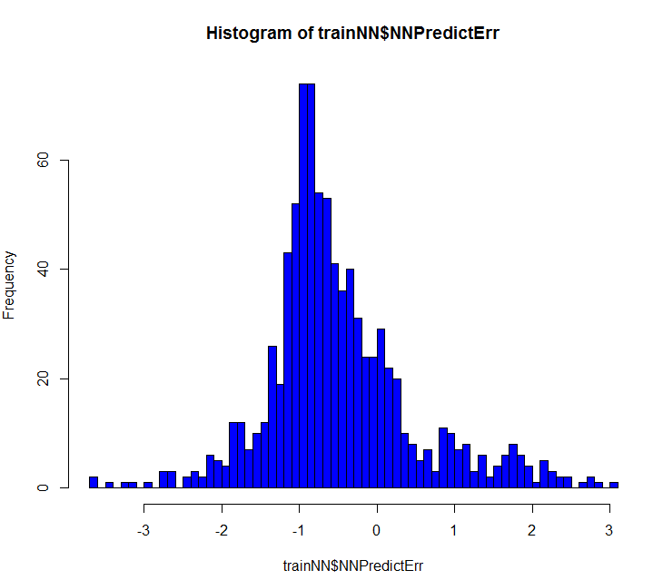
Modeling Step Neural Network – Prediction Results with Chosen Configuration
Network Used
Predictions vs Actuals
Actual (Normalized)
Multiple R-squared: 0.3209668,
Adjusted R-squared: 0.320189
Results and Preliminary Conclusions
The neural network shown above was chosen from different configurations tested with test data. It was trained with training data from a daily set of observations from 1999 through 2013
The validation data was then input to the NN and predictions computed
The predictions were plotted against the actuals on the plot on the top right and a best fit line drawn
If the predictions are 100 % accurate we would see a diagonal straight line
The errors were computed across the validation data and plotted on the histogram on the right
Error = (PredictedReturn / Actual Return) / ActualReturn
The plot does not show a very close correlation of predicted to actual;
The histogram shows significant levels of errors, tending to underestimate the actual
Preliminary Conclusion ; this NN does not accurately predict expected results .. HOWEVER I next looked at the results in a different way ->
Prediction (Normalized)
Error Distribution
(denormalized)
Frequency
Prediction Error (De Normalized)
= (Predic-Actual)/Actual

Slide 58
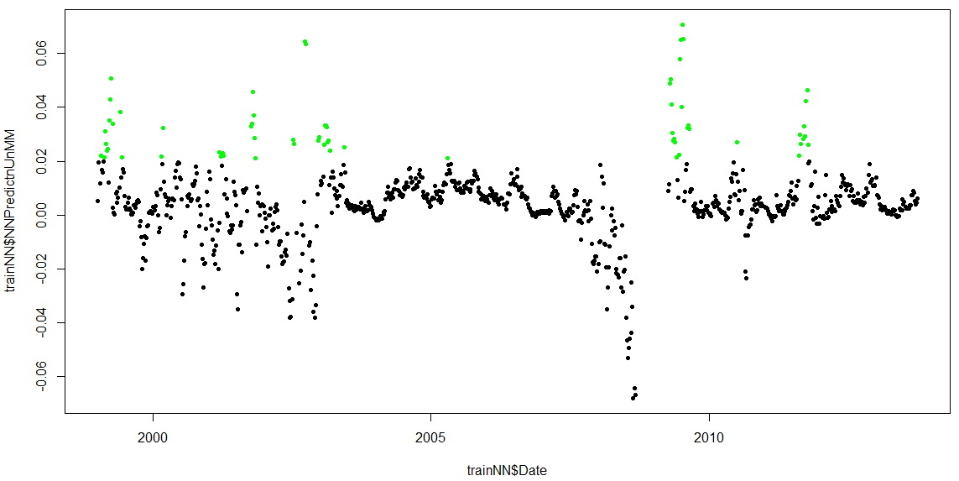
Validation Step Neural Network – Validation Results
Results Conclusions
Since the actual Return predictions of the NN proved disappointing, the predicted Returns were plotted as time series to confirm how they related to the actual DJIA index
The plot on the top right has predicted results and in Red highlights those that are less than 0.02.
The plot on the bottom right has predicted results and in Green highlights those that higher than 0.02.
Conclusions
Setting Predicted Return <= 0.02 as a a Buy Signal generated fairly accurate signals, especially if the signals occur in sequence over a small period of time
Setting Predicted Return <= -0.02 as a Sell signal generated mostly accurate Sell signals, especially if the signals occur in sequence over a small period of time
The shape of the predictions plot compared to the DJIA plot shows promise – further tuning may yield better predictions
Prediction <=-0.02
NN Return Predictions
DJIA Level
Year 1999- 2013
Accurate Sell signals
False Sell signals
DJIA Levels(no outliers)
FJIA Level
Year 1999- 2013
NN Return Predictions
Predicted Return Rate
Accurate Sell signals
Accurate Buy signals
Accurate Buy signals
Prediction >= 0.02
Year 1999- 2013
False Sell signals

Slide 59
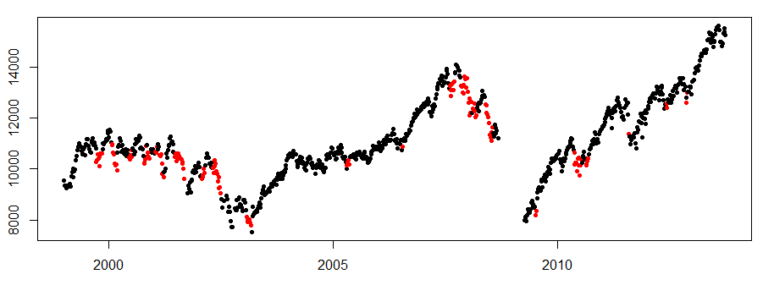
Overall Results - I
kMeans: ‘sell’ Cluster
Conclusions
Cluster analysis is useful in providing insight into the type of market conditions the current observation resembles from past experience, especially in identifying a ‘Sell’ cluster
C50 did a reasonable job of raising Sell and Buy signals, better with Buys
NN did not do a good job of predicting returns but did better in raising Buy / Sell signals – especially Buy signals
The plots on the right show the models in in tandem, with Buy and Sell signals based on a 3 consistent and consecutive within each model, with corresponding Entry and Exit points based on signals across the models
DJIA Level
1999 – 2013
Buy predictions C50
C50 Buy Predictions
FJIA Level
1999 – 2013
Neural Network Buy Signals
Buy Signal (3 consecutive)
Prediction >= 0.02 NN
Sell Signal (3 consecutive)
Predicted Return Rate
Conflicting Signal – Hold ?
Entry
1999 – 2013
Exit
Hold ?

Slide 60
Overall Results
kMeans: ‘sell’ Cluster
C50 & NN Sell Recommendations (in Red)
Conclusions
C50 did a reasonable job of raising Sell and Buy signals, better with Buys
NN did not do a good job of predicting returns but did better in raising Buy / Sell signals – especially Buy signals
The charts on the right show a different view of the signals. The C50 and NN Sell and Buy signals are shown in one plot, and Signals identified when there are 4 or more consecutive consistent predictions
Based on these signals, entry and exit points are shown, with shaded areas for signals to be In the market and Out of the market
The combination of models make a very good job of identifying when to be in the market and when to be out
DJIA Level
C50 & NN Buy Recommendations (in Green)
Buy Signal (4 consecutive)
Sell Signal (4 consecutive)
Conflicting Signal – Hold ?
In Market
Out of Market
Hold

Slide 61
Recommended Next Steps
Create a predictive model that takes in as input a series of signals from the other models to trigger an entry or exit from the market
Back test the model
In
Latest Observation
kMeans
C50
NN
Nearest
cluster
Buy / Hold /
Sell ?
Predicted Return
 | Clusters |  |  |  | C50 Decision Tree |  |  |  | Neural Network
 | Now | Prior | Prior - 2 | Prior - 3 | Now | Prior | Prior - 2 | Prior - 3 | Now | Prior | Prior - 2 | Prior - 3
Date
‘Buffer’
Predictions for last X Observations
NN 2
Out
Recommendation

